Slide 1


Slide 2



Establishment- 1976
Founder- Late Mr. L. D. Kotian
CMD- Mr. Padmakar Kotian
Business Model- Agents / Vendors
Recognition- FPBAI & GOC
Industry Experience- 4 Decades
Products- Print Journals / E-Journals, Periodicals, Databases, Back Issues & E-Books
Authorized Agents- John Wiley & sons Ltd., Wolters Kluwer Health/Ovid, Jaypee Brothers Medical Publishers Ltd.

Slide 3


`
Year Founded
1976
Approx. 300 Customers
Pan India
Effective SCM
CRM
Authorized Agent
3 Branches

Slide 4


Slide 5












Slide 6

Government Institutes
Indian Institute of Technology Bombay, Mumbai
Management
Institutes
Jamnalal Bajaj Institute of Management Studies, Mumbai
Research Centre
Advanced Centre for Treatment, Research & Education in Cancer (ACTREC), Navi Mumbai
Universities
S. P Jain Institute of Management Research, Mumbai
Bharati Vidyapeeth’s Institute of Management and Information Technology, Navi Mumbai
Symbiosis institute, Pune
Reserve Bank of India, Mumbai
Bhabha Atomic Research Centre, Mumbai
Mumbai Metropolitan Region Development Authority, Mumbai
University of Mumbai
University of Pune
Bangalore University
Marathwada University
Peerless Hospital & B. K. Roy Research Center, Kolkata
Indira Gandhi Institute of Development Research, Mumbai
National Institute for Research in Reproductive Health (ICMR), Mumbai

Slide 7
Corporate
CIPLA, Mumbai
Dental Colleges
Government Dental College, Mumbai
Hospitals
Tata Memorial Hospital, Mumbai
Medical Colleges
Reliance Industries, Mumbai
ONGC, Mumbai, Navi Mumbai, Vadodara
L & T, Mumbai
Seth G. S. Medical College & K.E.M. Hospital, Mumbai
Kasturba Medical College, Mangaluru
Sree Narayana Institute of Medical Science, Kerala
D.Y. Patil Medical College, Mumbai
A. B. Shetty Memorial Institute of Dental Sciences, Mangaluru
D.Y. Pail Dental College, Mumbai & Pune
Meghana Institute of Dental Science, Telangana
Breach Candy Hospital & Research Centre, Mumbai
Bombay Hospital, Mumbai & Indore
Deenanath Mangeshkar Hospital & Research Centre, Pune

Slide 8
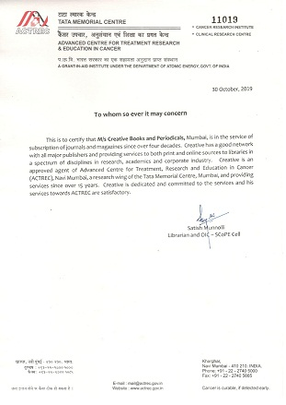
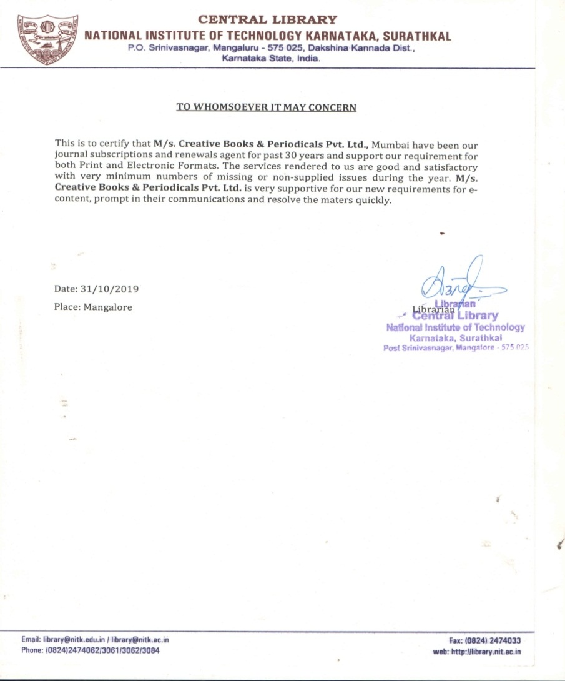

Slide 9
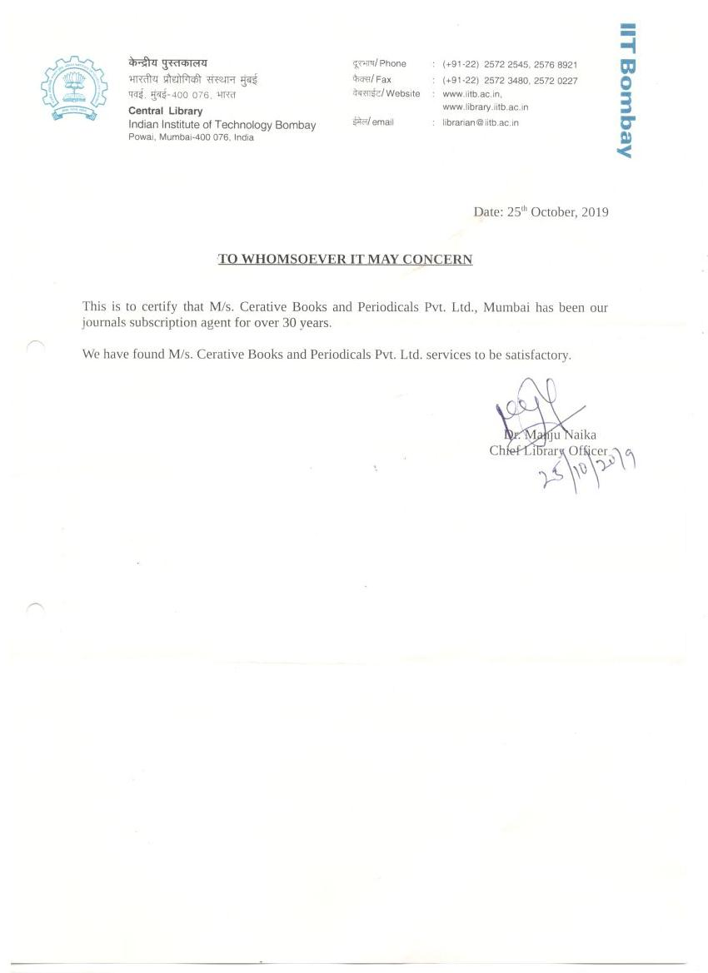
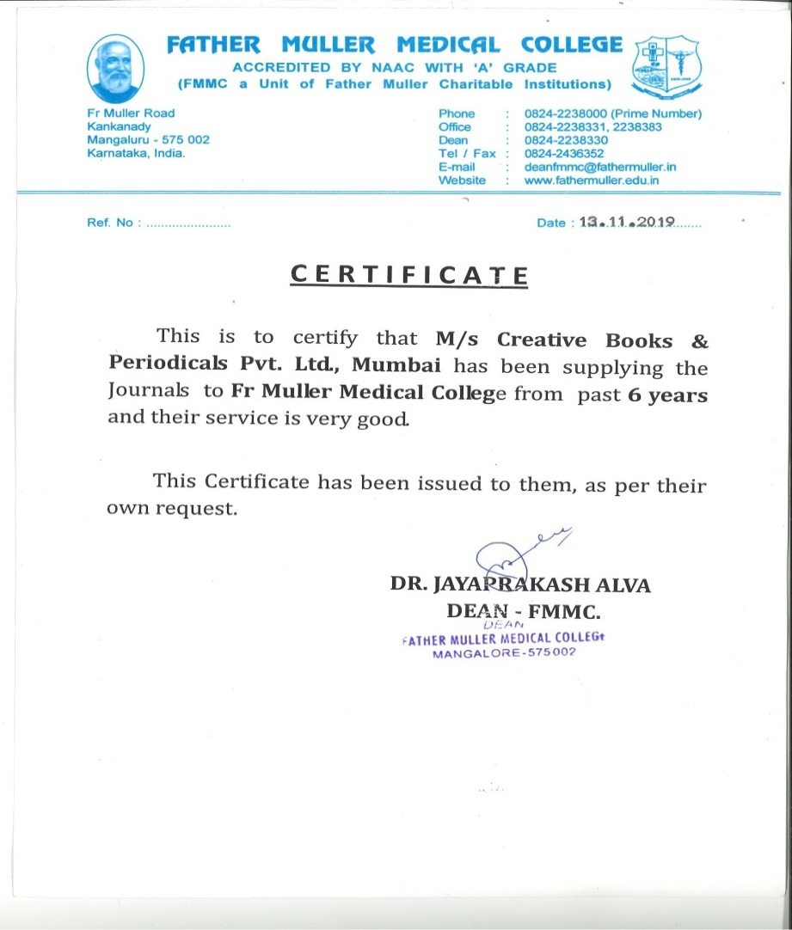

Slide 10


