Slide 1
Tools and Techniques for Enhancing the Research Impact: An Overview
Mugdha A Raul
Scientific Assistant’
mgokhale@actrec.gov.in
and
Satish S Munnolli
Librarian and OIC Scope Cell
Advanced Centre for Treatment Research and Education in Cancer, TMC
Kharghar, Navi Mumbai-410210
smunnolli@actrec.gov.in

Slide 2
Scholarly Communication in 21st Century
Scholarly communication is an integral part of scientific communication. In the 21st century the word communication has undergone a dramatic change and social media has emerged as a vital tool for exchange of thoughts and ideas instantly.
With the open Access initiatives the research has stepped out of the closed laboratory walls and has reached to the larger community.
Advancement of ICT has enabled scholars to communicate their research findings in various publishing models.
The reach of science in present scenario is within seconds and one can disseminate and communicate science in several ways and means.

Slide 3
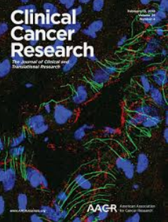





Media of Scientific Communication

Slide 4
Tools for Enhancing the Impact of Scholarly Literature
Publishing in Open Access Journals
Publishing in open access journals gives easy access to scientific knowledge. The article published in open access journal tends to get more citations which ultimately increases the reach of research.
ORCID( Open Researcher and Contribution ID)
It is unique digital ID assigned to an author in the scientific world. It can be connected with Author identifier, Scopus, Google Scholar Researchers record gets updated when his work is published.
Archiving of Publications in Institutional Repositories

Slide 5
Tools for Enhancing the Impact of Scholarly Literature
Image Banks
An Image bank is a web-based image gallery which provides thousands of images from different experiments and research findings. It is a repository for storing the images. MedPix is free open-access online database of medical images, teaching cases, and clinical topics, integrating images and textual metadata including over 12,000 patient case scenarios, 9,000 topics, and nearly 59,000 images are available in this source.

Slide 6
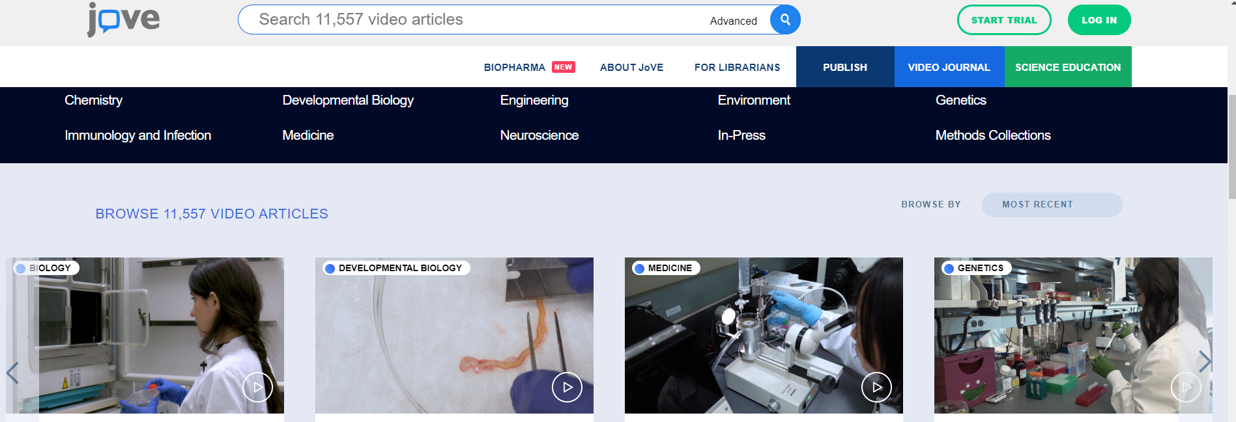
Online Visual Journals
Worlds first video journal in science is Journal of Visualized Experiments(JoVE). It contains more than 11000 video articles from biomedicine to translational medicine. It has two sections JoVE video journal and JoVE Science Education.

Slide 7
Use of Social Media for Enhancing The Research Impact
Social media is the most popular platform which facilitates creating and sharing information. Following are the few media platforms which can be used by academicians to increase the impact of scholarly communication.
ResearchGate: It is the social networking site for researchers to share papers, ask and answer questions and find collaborators in the same field of research.
Mendley: It is an online reference manager and academic social network tool. One can use mendley for managing and citing while writing the paper. It also helps in discovering the research data.

Slide 8




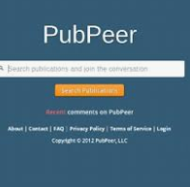
Social Media Platforms

Slide 9
Science Blogs
Science blogs are popular platforms for discussion on any research, new scientific concepts.
Scholarly Kitchen
Scholarly Kitchen which is published by Society for Scholarly Publishing , aims to advance scholarly publishing and communication to help the professional development of the researcher. It allows putting different opinion thoughts and ideas on a single platform without any restrictions. It has unique podcast feature which contains interviews with expert regarding the different trends in scholarly communication.

Slide 10
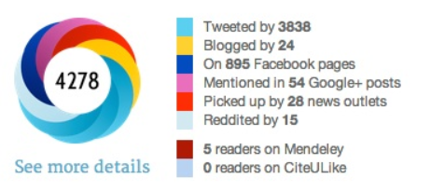
Altmetrics
Altmetrics is one of the most popular tools for measuring the rapid scholarly activity of researcher. This tool captures the attention received by any article on social media and count them with score. Impact Story, Plum Analytics , Readermeter, Sciencecard, Papercritic, CrowdMeter are various altmetric tools. This tools captures a range of research communications from different platforms and present them in the form of score, graphics and visual effect. It is an interesting tool for researchers as well as publishers as both of them are able to analyse the impact of an article.

Slide 11
Role of Library Professionals
The internet has leveraged the communication models and the scholarly communication has taken a new leap. Availability of free access to scientific literature has many advantages as well as disadvantages. The role of library professionals plays a crucial role in this scenario. Identifying the right tools for showcasing the research and informing the researchers and academicians for the same will ultimately help in increase of research reach.

Slide 12


