Slide 1
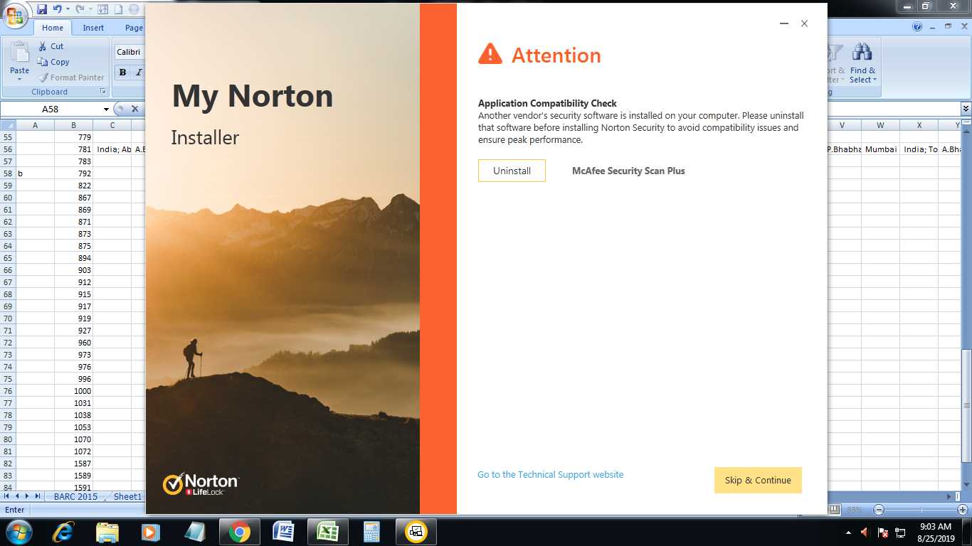
Mega-collaborated publications and their influence on scientometric profiles of research institutions
E.R. Prakash; Ganesh Surwase
Scientific Information Resource Division
Knowledge Management Group
Bhabha Atomic Research Centre, Mumbai, India
E-mail: prak@barc.gov.in

Slide 2
Mega-Collaborations
AGILE Team
ALICE Collaboration
ATLAS IBL Collaboration
CMS Collaboration
CMS HCAL Collaboration
CMS Tracker Collaboration
CTA Consortium
FACT Collaboration
Fermi-LAT Collaboration
F-Gamma Consortium
HESS Collaboration
IceCube Collaboration
MAGIC Collaboration
MWL Collaborators
NuSTAR Team
PICASSO Collaboration
PICO Collaboration
R3B Collaboration
Swift NuSTAR
TOTEM Collaboration
VERITAS Collaboration
VLA 17B-403 Team

Slide 3


Mega-Collaborated Publications
33-page article in Physical Review Letters
24-page list the authors and their institutions.
Only 9 pages describe the research
5,154 authors

Slide 4
Mega-Collaborated Publications and Scientometric Analyses
Do Mega-Collaborated Publications alter the scientometric parameters of institutions or even individuals???

Slide 5
Mega-Collaborated Publications of Institutes
Institution | Papers without mega collaboration | Mega collaborated Papers | Total Papers | % of Mega Collaborated Papers
Bhabha Atomic Research Centre, Mumbai (BARC) | 10867 | 2264 | 13131 | 17.24
Saha Institute of Nuclear Physics, Kolkata (SINP) | 2725 | 1109 | 3834 | 28.93
Tata Institute of Fundamental Research, Mumbai (TIFR) | 6389 | 1572 | 7961 | 19.75
Web of Science Data from 2009 to 2018

Slide 6
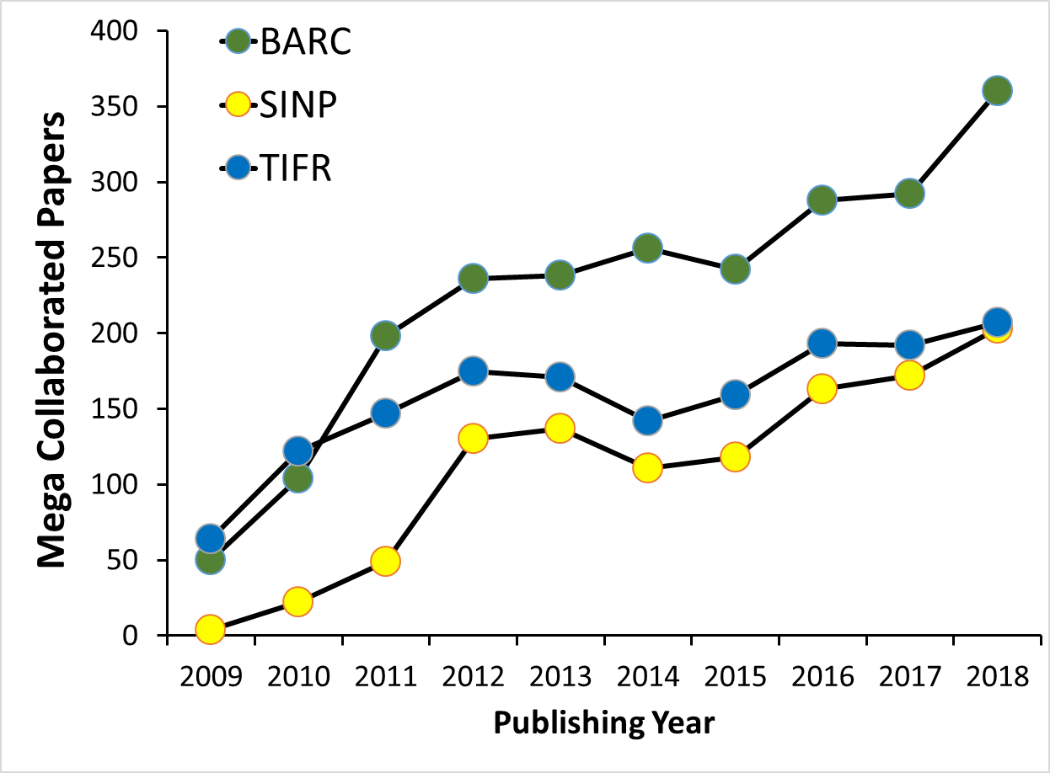
Mega-Collaborated Publications – Chronological Trend

Slide 7
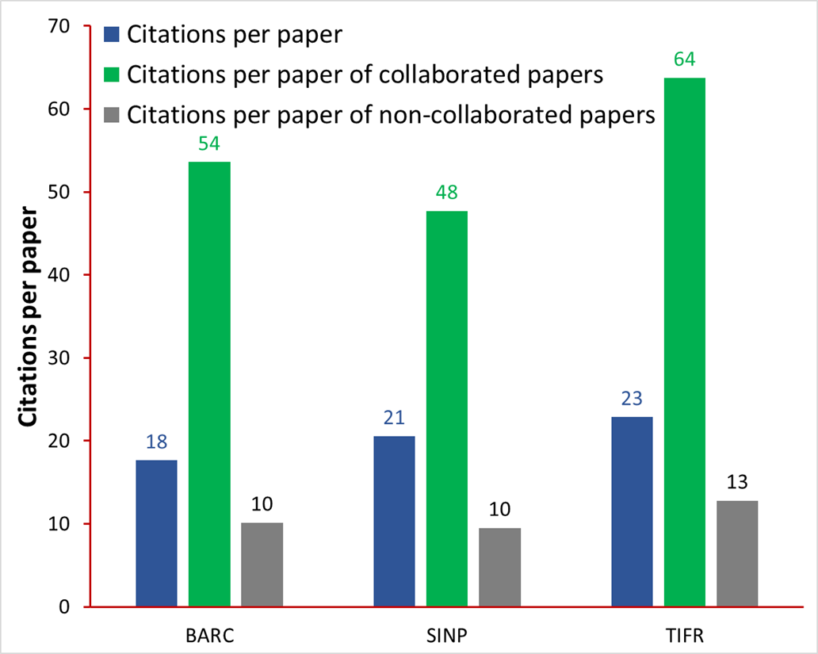
Mega-Collaborated Publications – Trend of Citations

Slide 8
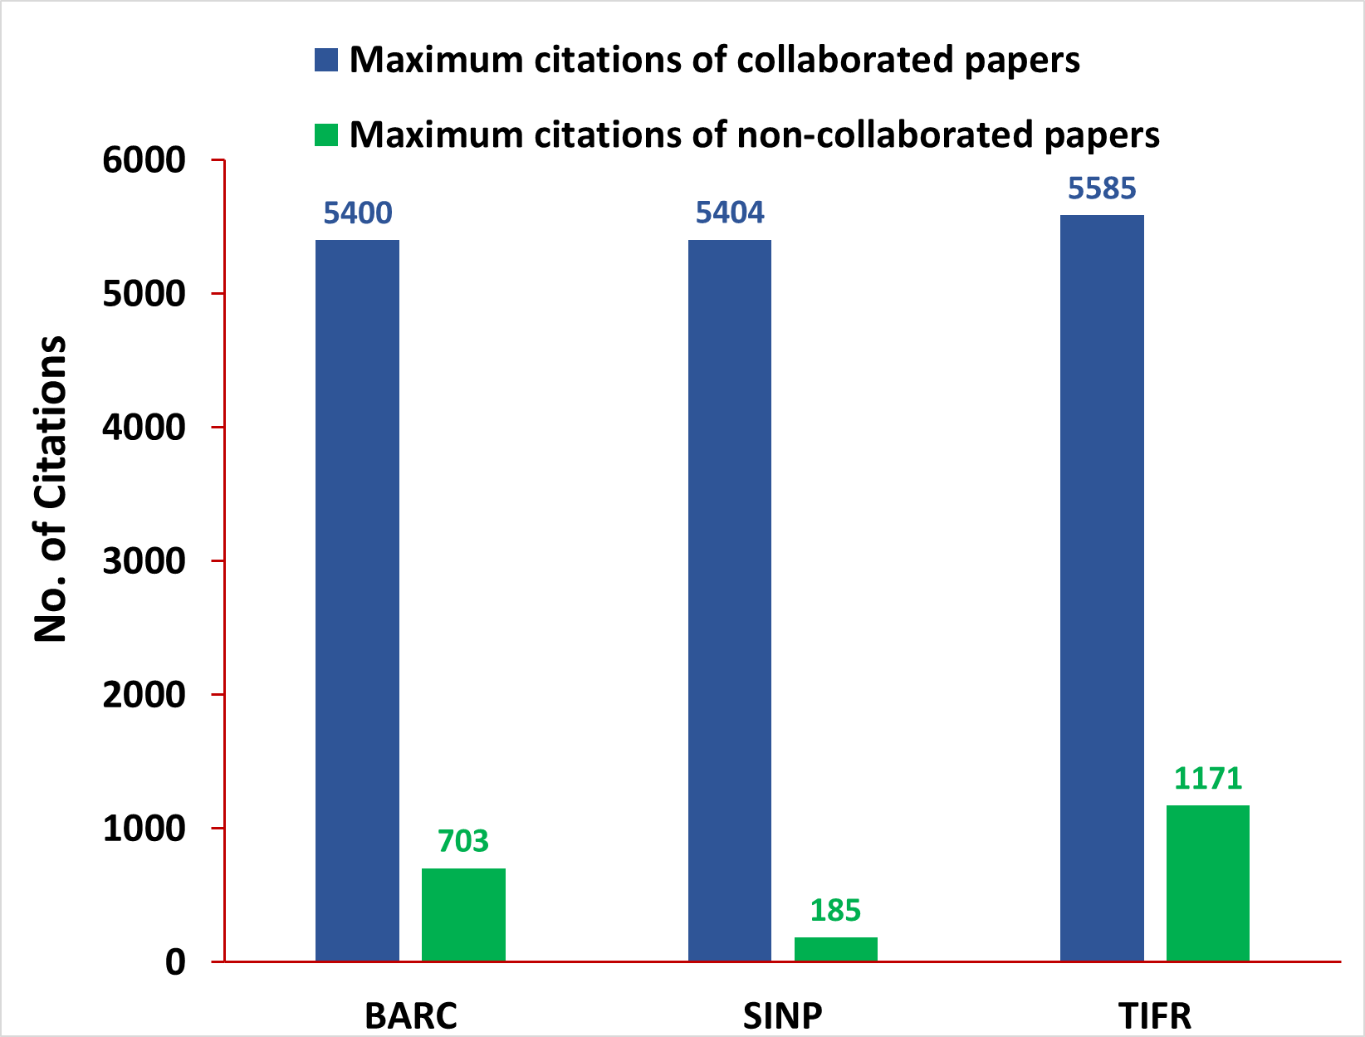
Mega-Collaborated Publications – Maximum Citations

Slide 9
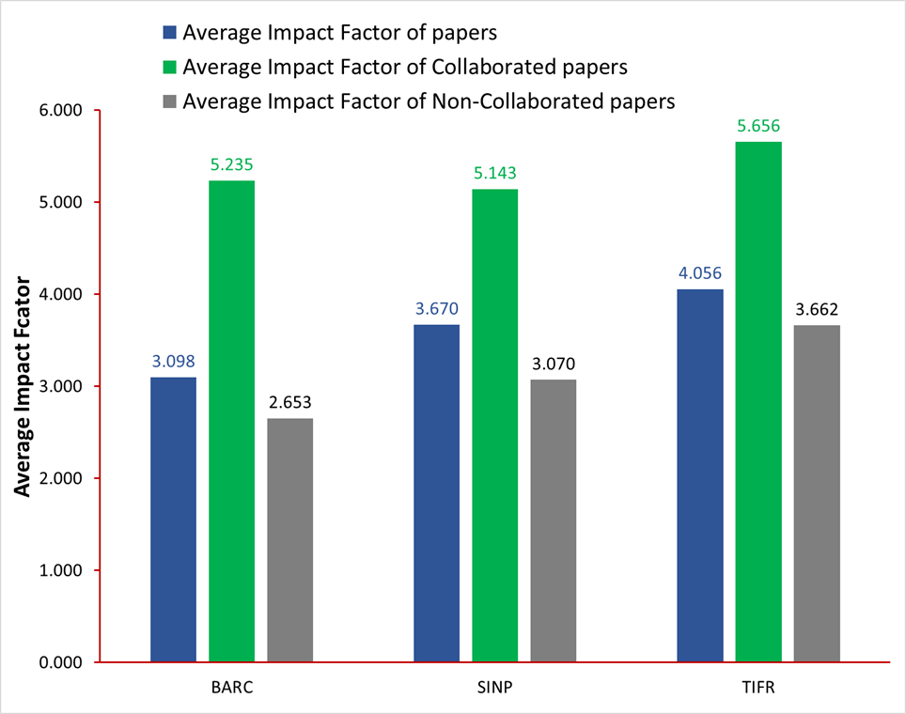
Mega-Collaborated Publications – Average Impact Factors

Slide 10
Conclusions
The results of the study explicitly reveal the fact that the mega-collaborated publications alter the scientometric profiles of institutions with scientists working in mega projects like CMS, ATLAS etc.
The comparison or benchmarking of the institutions with or without mega-collaborations lead to wrong representations.
Even within institutes, there is a possibility that the evaluation of research performances based on publications may have drastic variations when some departments have mega-collaborated publications.
These facts must be an eye opener for research evaluators and scientometricians when they look at publications of the institute ignoring the international collaboration.

