Slide 1
SCIENTOMETRICS: CREDIT SCORE CHALLENGES
Praveen B. Gawali
Indian Institute of Geomagnetism
Navi Mumbai
23-11-2019

Slide 2
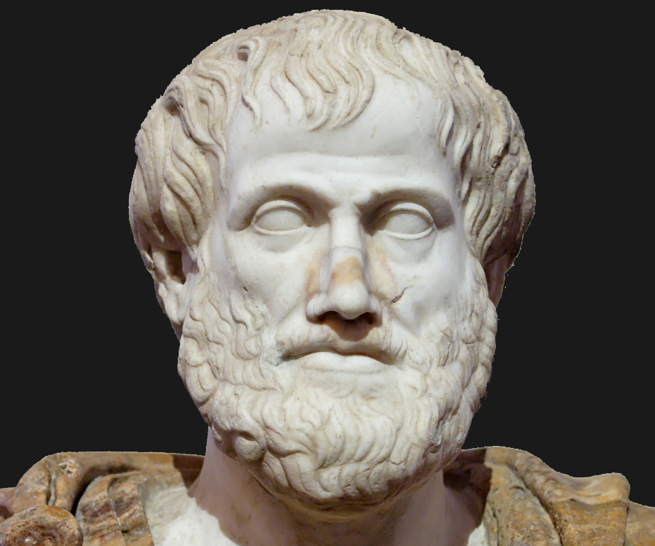
Generational or Vertical Transfer of Knowledge
Science is a progression of knowledge
The results are repeatable and neutral
The story starts with Aristotle…
One of the greatest minds of the world: Aristotle: Universe made of five elements, hot and cold, circular motion, heavy bodies fall faster than light
But, Pythagoras, 200 years prior had propounded circular motion

Slide 3
Copernicus got the first inkling of heliocentric universe from Pythagoras
Ptolemy predicted the future positions of planets though he had an unshakeable faith in geocentric universe
Greek astronomer Aristarchus of Samos had already predicted, not proved, that the sun was at the center

Slide 4
Tycho Brahe and Johannes Kepler improved upon Copernicus’ conclusions.
Kepler showed that the orbits of the planets were slightly elliptical and that they do not move about the sun in perfect circles.
Kepler himself did not believe this because of Aristotle.
Tycho Brahe also opposed heliocentric concept. He felt laws of god were violated.

Slide 5
To show that earth is at the center and not the sun, he made innumerable observations, published in 1592. He accepted the sun centric view and allowed Kepler to be his assistant and successor.
Galileo was not so fortunate as Kepler. He actively demolished may Aristotalean truths, he was punished for those going against the church. But he was an experimentalist. He carried out many experiments, the most famous being the fall of uneven weights and frictionless motion. These were the clues to Newton to formulate his idea of inertia and first law of motion.

Slide 6
The Cross Cutters and Mavericks
The gravitation theory enunciated in Principia by Newton is linked to a controversy. Robert Hooke had delivered a lecture before the Royal Society of London enunciating his understanding of the law of universal gravitation. This lecture took place five years before Principia was published. Hooke was upset that his work was not acknowledged.
Hooke also accused Christian Huygens of appropriating his discovery of oscillations of coiled springs were practically synchronous. This property can be used to keep time. Hooke was building this watch, but it was Huygens who completed 3 months before and patented this idea.
But, Huygens got this idea from Galileo who timed the oscillations of a pendulum, with his pulse, while in church and found them to be constant even when the swings got smaller.
Huygens is also famous for enunciating the theory of light and felt light spreads in waves. Newton, on the other hand, advanced corpuscular theory. James Clerk Maxwell showed wave theory was applicable.
But then Einstein and Max Planck came along and revived the corpuscular theory in the study of photoelectricity. Modern views or the theory of everything combines both these theories.

Slide 7
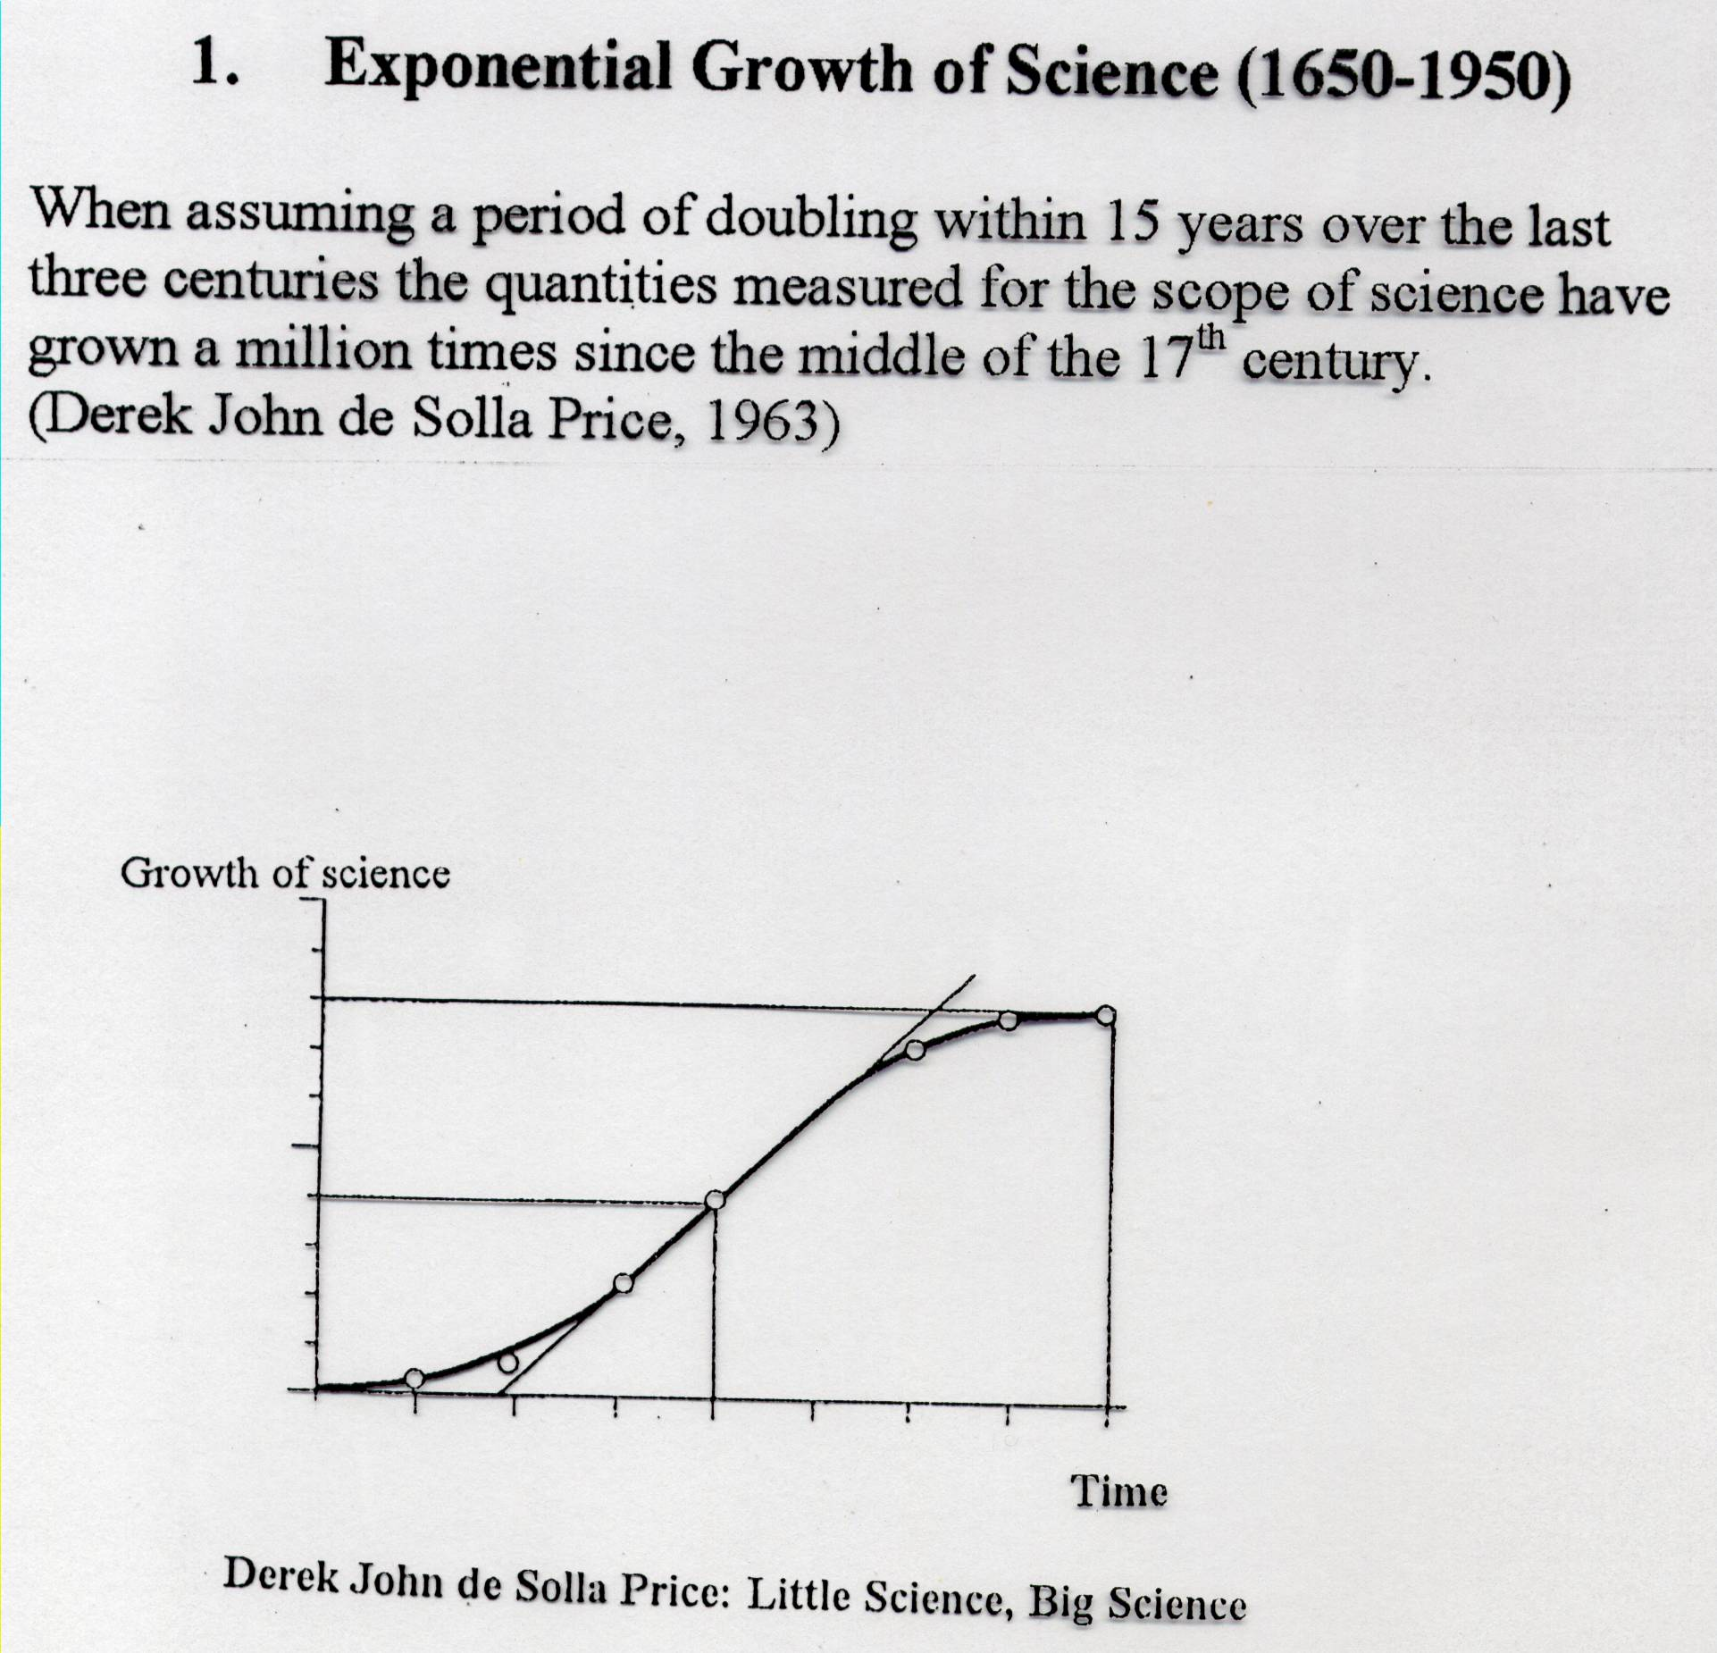

Slide 8
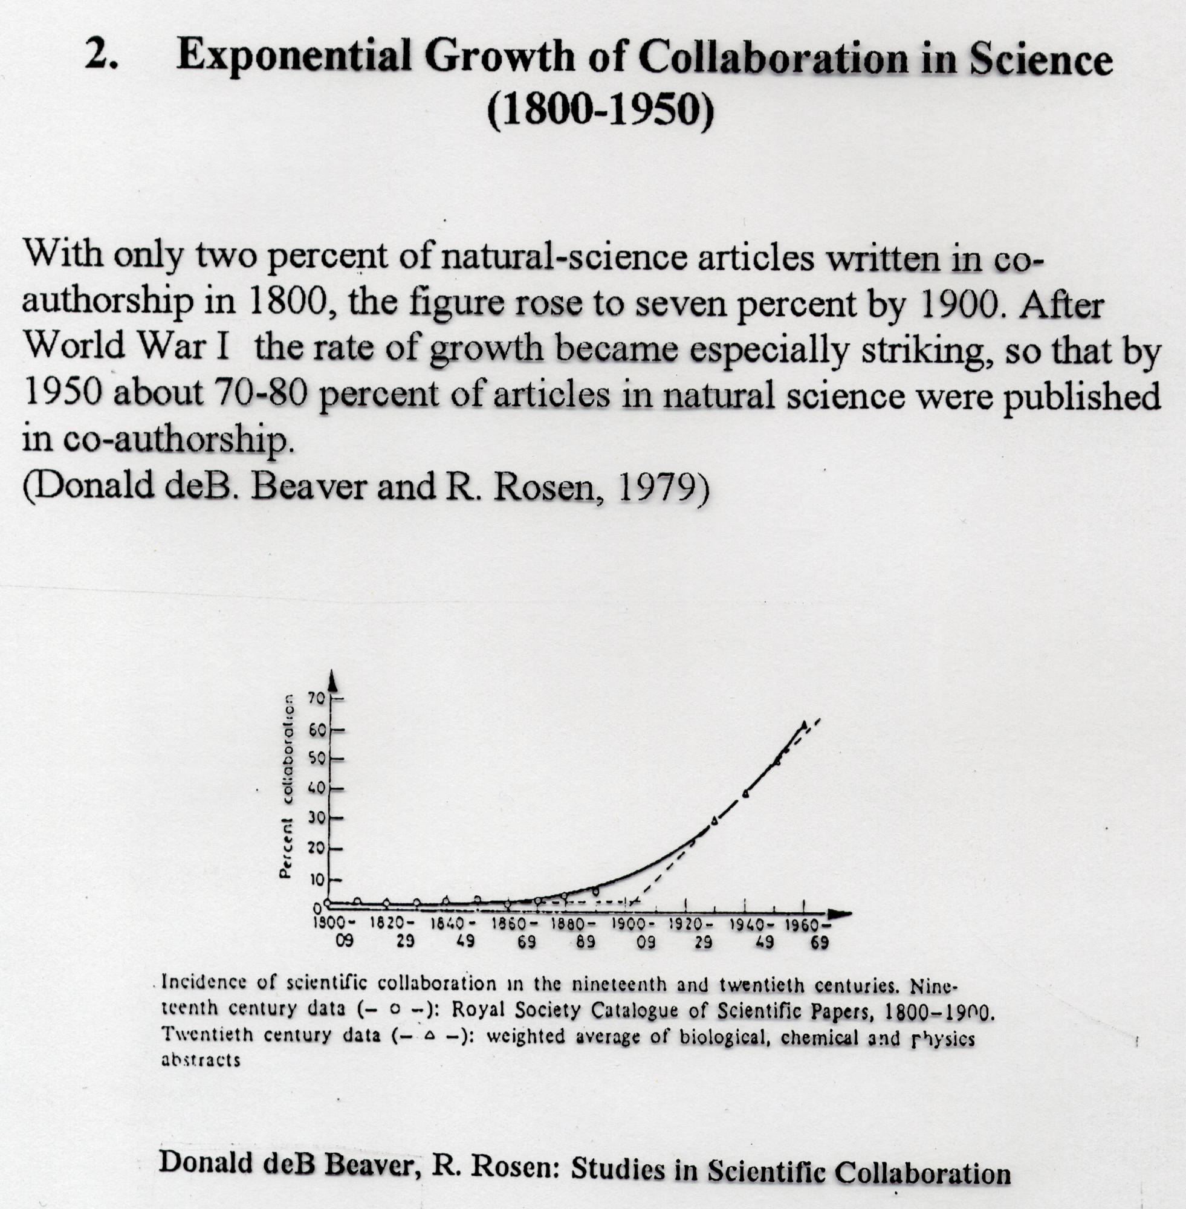

Slide 9
Scientific communication: Classic Model
(prior to Web / open access)
TechnicalResearch report
Peers
Un-published
non-peer review
informal com.
Archive
Library
index
Research idea & activities
Conf.
Papers
(Peer reviewed)
Journal
Articles
(Peer reviewed)
Domain databases
Citation
database
Time

Slide 10
Scientific communication: Present Model
(incl. Web / open access)
Technical Research reports
Working
papers
Peers
Un-published
public
Non Peer review
Inst. Repositories
Open access journals
Journal
Articles
(Peer reviewed)
Full text
Domain database
Conf.
Papers
(Peer reviewed)
Research idea & activities
- Web of
Science
- Scopus
Google (Scholar)
Academic Web Search Engines
Time

Slide 11
Scientific communication:
What ’is’ scientific information?
Confidence in information source?
Authoritative source
Research output
Open Access
- Journals (peer reviewed)
- Inst. Repositories
(Duplicates/versions)
Restricted Access
- Journal articles
(peer reviewed)
Working papers
Research reports
Blogs …
Conference Papers
Posters, Abstracts (peer reviewed)
Collaboratory round tables
Restricted Access
- Research Monographs
(peer reviewed)
Teaching material
Searchable on Open Web
Partly searchable on Open Web
Qualified knowledge source
(Domain dependent )

Slide 12
Scientometrics Analysis
Scientometrics is concerned with the analysis of informational dimensions of science, such as
Publications
Patents
Journals
Laws of ageing and scatter of scientific information
Citation processes, etc.

Slide 13
Application of Scientometrics:
Literature searching
Assessing the adequacy and coverage of library collections
Studying scientific communication
Exploring cooperative and social relationships in science
Evaluating scientific performance

Slide 14
Peer Review: A Challenge
The beginning of information exchange was quite humble and simple. The scientific renaissance saw the exchange of seminal ideas between many thinkers and philosophers of the age through letters and note to one another. However, the explosion of scientific reasoning and thinking dramatically increased the entities doing science. A need was felt to send the information from different workers to a single person, who in turn, disseminated it to all others. The Philosophical Transactions of the Royal Society was thus founded in 1660 precisely for this purpose, which also saw the emergence of peer review system (Oldenberg, 2019).
The peer review is one funnel that weeds out extraneous and spurious claims that do not stand scientific rigour and scrutiny. It is an intermediary that has become as essential as the researcher itself in carrying out research of great repute and standing. The reviewer, as an independent entity, is instituted with the responsibility of identifying irrelevant and irresponsible research. But there are some practicalities that are gnawing at the very process of peer review in the manner in which it is currently practiced.

Slide 15
When Eugene Garfield produced the first Science Citation Index in 1964, he did so to make searching the literature more efficient and effective. He called his creation an “association-of-ideas index.” And the connections he captured between topics, concepts, or methods discussed in indexed papers could be trusted, he argued, because they were based on the informed judgments of researchers themselves, as recorded in the references they appended to their papers.
Robert K. Merton, the 20th century’s leading sociologist of science, called the citation “a pellet of peer recognition.” Citations, he said, were repayments of an intellectual debt to others.
Highly Cited Researchers are those who have demonstrated significant and broad influence reflected in their publication of multiple papers, highly cited by their peers over the course of time
There is no unique or universally agreed concept of what constitutes extraordinary research performance
Highly Cited Researchers wield a vastly disproportionate influence on their fields

Slide 16
Change is Round the Corner
The winds of change are knocking at the doors which can be seen via platforms like
quantum (https://quantum-journal.org/),
researchers.one (https://www.researchers.one/) and
SciPost (https://scipost.org/).
These are some of the attempts aimed at attempting novel and innovative approaches.
They are trying out transparent peer review and putting out user comments and even doing away with accepting or rejecting of the manuscripts.

Slide 17
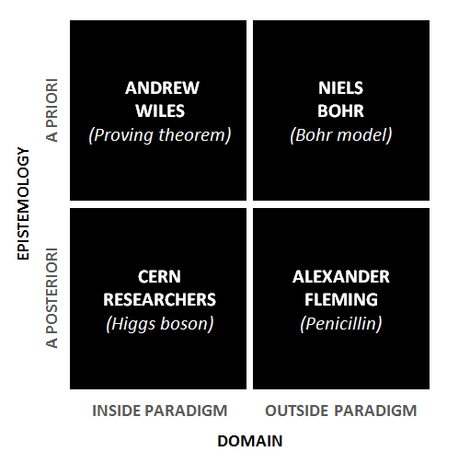
The Way Forward
The Challenge of Identifying the kind of Scientist one is

Slide 18
What type of scientist are you?
Here, an example of an a priori study that is conducted within an existing paradigm can be illustrated by Andrew Wiles, a British mathematician best known for proving Fermat’s last theorem.
Wiles solved the famous problem, Fermat’s last theorem, which had stumped mathematicians for 350 years. It was an established problem (existing paradigm) that Wiles had pondered for several years (a priori), and solving it won him the 2016 Abel Prize.
The strength of this type of scientist is that they are able to work on established problems in the field, but the limitation can be that they sometimes prefer to work individually rather than collaboratively.
A different approach is illustrated by Alexander Fleming, who famously discovered penicillin by accident.
Fleming had placed an uncovered petri dish near a window, which became contaminated with mould. Instead of merely throwing out the dish, he realized that bacteria near the mold were dying, which resulted in the identification of Penicillin.
Fleming’s discovery required him to move outside his paradigm when faced with the petri dish (a posteriori). The strength of this type of scientist is that they can make new, data-driven discoveries, but they risk becoming distracted by many different observations at once.

Slide 19
What type of scientist are you?
If we look within the field of physics, we can illustrate the two remaining archetypes.
Niels Bohr came up with the Bohr model through a conceptual approach that was a priori, but outside the existing paradigm. The Bohr model of the atom was the first that incorporated quantum theory, and it therefore departed radically from previous descriptions of the atom.
The strength of this type of scientist is that they can create entirely new paradigms, but the limitation can be that they risk becoming too isolated from the mainstream.
More recently, technological advancements have allowed physicists to run real-world experiments on previous conceptual work, as illustrated by the discovery of the Higgs boson particle by CERN scientists, which was a posteriori and inside the existing paradigm.
The strength of this type of scientist is that they can use data to build cumulative knowledge in the field, but the limitation can be that they might be reluctant to look outside their field to challenge underlying assumptions.
Although Wiles and the CERN researchers worked on problems that were typical of their fields, both Bohr and Fleming worked ‘outside the box’ in how they approached and reframed their objects of study.
As much as serendipity is acknowledged to advance scientific breakthroughs, it could be argued that the ability to work in an unconventional way like Fleming did is harder today than it was more than a century ago due to current publication pressures, research requirements and diverse deadlines.

Slide 20
Co-first Authors
Multiple people contribute equally to a particular work is not evident

Slide 21
THANK YOU
References
Carsten Lund Pedersen & Thomas Ritter. 2019. What kind of scientist are you? Nature
Oldenberg Henry. Accessed on 14-10-2019. https://en.wikipedia.org/wiki/Henry_Oldenburg
Editorial. The rise of the platforms. 2019. Nature Physics, VOL 15, 871, https://doi.org/10.1038/s41567-019-0667-5
Roemer Robin Chin and Borchardt Rachel. 2015. Altmetrics. Library Technology Reports. alatechsource.org
R. Sinatra, D. Wang, P. Deville, C. Song, A.-L. Barabási, 2016. Quantifying the evolution of individual scientific impact. Science 354, aaf5239 (2016). doi: 10.1126/science.aaf5239; pmid: 27811240
Web of Science. 2019. Highly cited researchers

