Slide 1

Plan S:
An Opportunity or Challenge to Open Access
Dr. Sadanand Y. Bansode
HoD & Professor, Library and Information Science
Savitribai Phule Pune University
Pune, Maharashtra
E-mail: sadanand@unipune.ac.in
Sunita S. Pujar
Librarian
Durgadevi Saraf Institute of Management Studies
Mumbai, Maharashtra
E-mail: sunita.pujar@dsims.org.in

Slide 2
Agenda
Introduction
What is Plan S?
10 Commandments/Principles of Plan S
Plan S Compliance
Plans S: Implications to Scholarly Communication
Conclusion

Slide 3
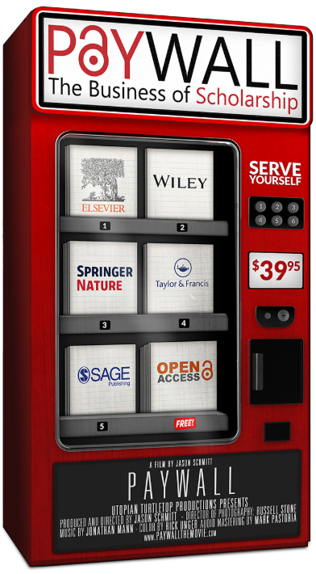
Introduction
Today the research system is in transition with a ever increasing scientific research output in multiple formats
However, numerous number of journals till today require subscription to get access to this knowledge
Open Access started in 2000s made it possible certain percentage of this knowledge free to everyone. In 2015 this percentage stood at 45
Even then, open access achieved a limited success in making worlds research output open in spite of best efforts of governments, funders and individuals
Plan S intends to accelerate the transition towards open access by making it compulsory for researchers to make their publicly funded research available in open access
Source: https://www.imdb.com/title/tt8657152/

Slide 4
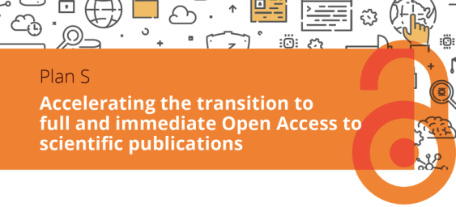
What is Plan S?
Plan S is an initiative for Open Access publishing that was launched in September 2018 and its guidelines were revised in May 2019.
It has been supported by cOAlition S, an international consortium of research funders (largely European research councils).
Plan S requires that, with effect from 2021, all scholarly publications on the results from research funded by public or private grants, must be published in Open Access Journals or on Open Access Platforms, or through Open Access Repositories without embargo.
It requires authors to publish articles in open access using creative commons CC-BY with a possibility to use CC-BY-ND
Publication in hybrid journals is not allowed except where institutions have signed transformative agreements with publishers until 2024.
It also insist on APC Caps, waivers for authors from lower income countries and discounts for authors from middle income countries

Slide 5
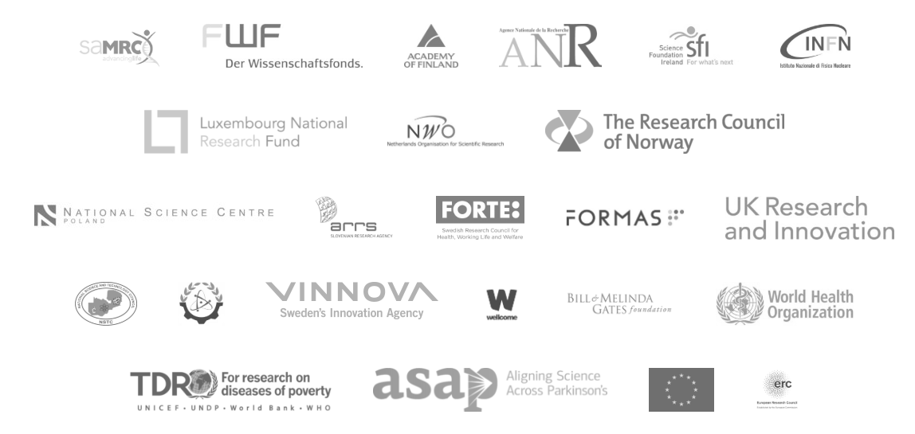

cOAlation S Supporters / Funders
National and International Funders and Supporters
Mainly Supported by

Slide 6
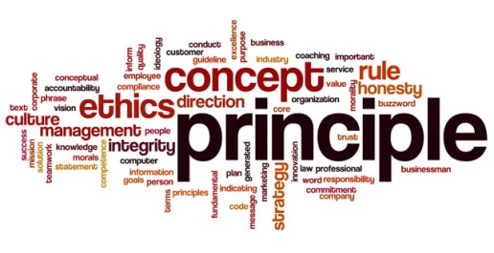
10 Commandments / Principles of Plans S
Authors or their institutions retain copyright to their publications. All publications must be published under an open license, preferably CC BY
The Funders will develop robust criteria and requirements for the high quality open access services
In cases, where high-quality Open Access journals or platforms do not exist, the funders will provide incentives to establish and support such initiatives
Where applicable, Open Access publication fees are covered by the Funders or research institutions, not by individual researchers
The Funders support the diversity of business models for Open Access journals and platforms

Slide 7

10 Commandments / Principles of Plan S
The Funders encourage governments, universities, research organizations, libraries, academies, and learned societies to align their strategies, policies, and practices
The above principles shall apply to all types of scholarly publications, but timeline to achieve Open Access for monographs and book chapters will be longer
The Funders do not support the ‘hybrid’ model of publishing, however, allow transformative arrangements
The Funders will monitor compliance and sanction non-compliant beneficiaries/grantees
The Funders commit that when assessing research outputs during funding decisions they will value the intrinsic merit of the work and not consider the publication channel

Slide 8
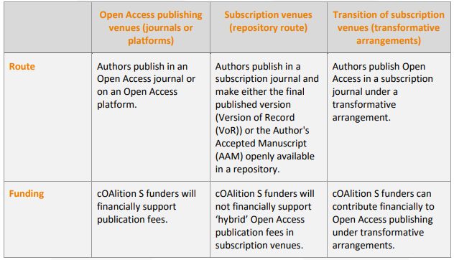
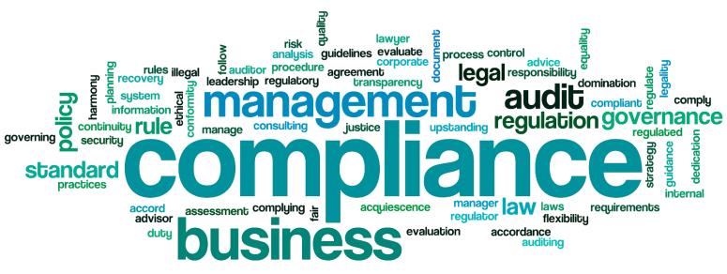
Plan S Compliance
cOAlition S plans to work with DOAJ, Open DOAR, SHERPA / RoMEO and ESAC to establish mechanisms whether journal publishers/ platforms and transformative arrangements will adhere to its requirements.
It expects publishing houses, open access journals, platforms and repositories to adhere to certain policies and technical requirements. Also support COPE guidelines.

Slide 9


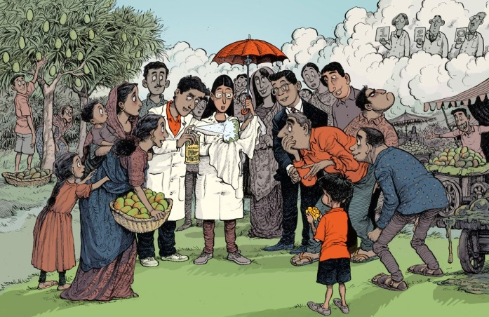



Plan S Implications to Scholarly Communication
Implications to Disciplines
Implications to Researchers
Implications to Publishers
Implications to Global South

Slide 10
Implications to Disciplines
Inequities among scholars from different disciplines and geographic backgrounds scenario may shift from unable to access to unable to publish owing to steep APCs
Funding APCs across disciplines varies and in case of Humanities and Social Sciences it is minimal or rare.

Slide 11
Implications to Researchers
Trying to manage research life of researchers asking
them where to publish using a specific route of Open Access.
Concentrate only on subscription based access of publishers without fully considering the researchers.
Plan S move asking researchers to publish publicly funded research in purely Gold OA journals result in increasing cost of publication and publication divide among researchers
Issues such as problem of affordability, quality and sustainability, exclusion and violation of academic freedom would divide the research community and Social Sciences it is minimal or rare.

Slide 12

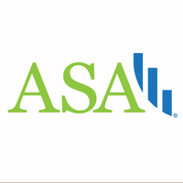
Implications to Publishers
Bigger publishers are upset in regard to banning of hybrid journals from publications
Removing publishing options undermines research publishing eco-system and unsustainable for businesses
Implications for society publications are much higher as it is solely dependent on subscription fees
Society publishers feel Plan S is an existential threat to their business model. Publishing articles with immediate open access with no subscriptions not an viable option and it may compromise the quality.

Slide 13
Implications to Global South
(Developing Countries)
Global South signing for Plan S may be double edge
sword as it may lead to pay for subscription fees and also to
publish in journals
Some of the experts suggested to follow the existing licensing model for read element and choose local solutions for publishing element rather than taking part and initiating Plan S.
India initially was thinking to join Plan S but now decided not to join it thus saving itself from APCs to be paid to authors as these range between $1000 to $ 5000.
https://www.nature.com/articles/d41586-018-05581-4

Slide 14
Conclusion
Plan S no doubt is very ambitious in accelerating open access
There is a enthusiasm and support for its goals but there is great deal of concerns in regard to its implementations guidelines
It has lot of gaps in regard to treating of subjects, journals not covered in DOAJ, Society publications and authors willingness to publish in open access journals.
If it addresses the issues raised by stakeholders, it may receive greater support from all the quarters and may lead to grander compliance from the publishers and researchers across the globe.

Slide 15
Thank You
Disclaimer: Ownership of images or logos is of respective organizations or individuals.
They have been used in this presentation only for academic purpose.

