Slide 1
Impediments of Indian Research
Dr. PV Konnur
President, LIS Academy, Bangalore
Advisor, VTU E-Resource Consortium, Belagavi
Syndicate Member, Kuvempu University, Shivamogga
pvkonnur@gmail.com

Slide 2
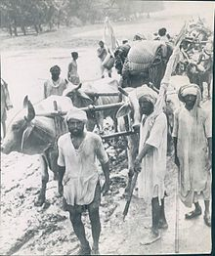
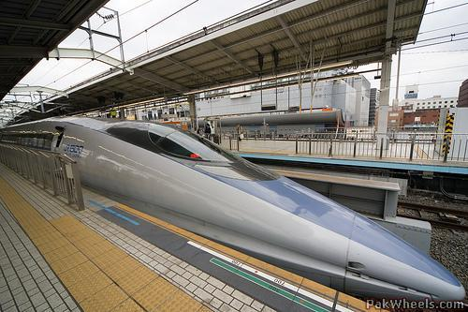
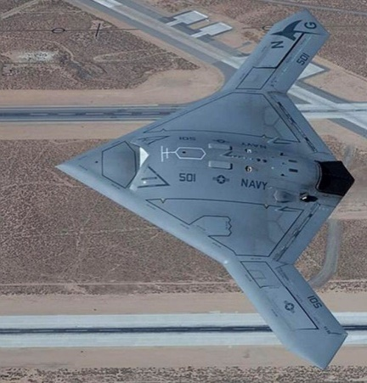
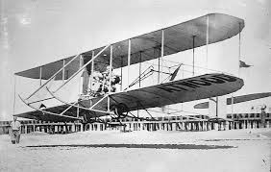


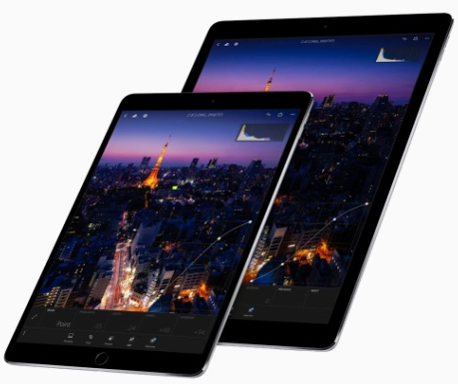

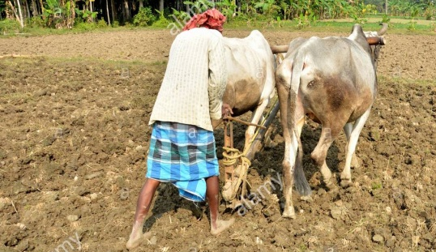
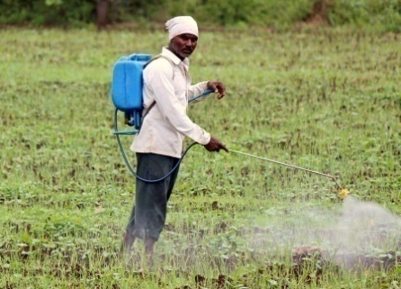
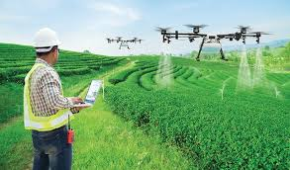

Research - Transforms
PAST
PRESENT

Slide 3
Research Impact
Societal
Impact of Quality Research
Academicals
Economical
Technological

Slide 4
Research in India
Research
Govt. Research Organizations
Higher Education Institutes
Private Organizations
ICAR
ICMR
CSIR
DST
DRDO
ISRO
DBT
Universities
  Central
  Private
  State
Inst. of Natl. Imp.
  IISc
  IITs
  NITs
  ISERs
GE
GM
BioCon
HP
Advinus
Honeywell
Many More!!

Slide 5
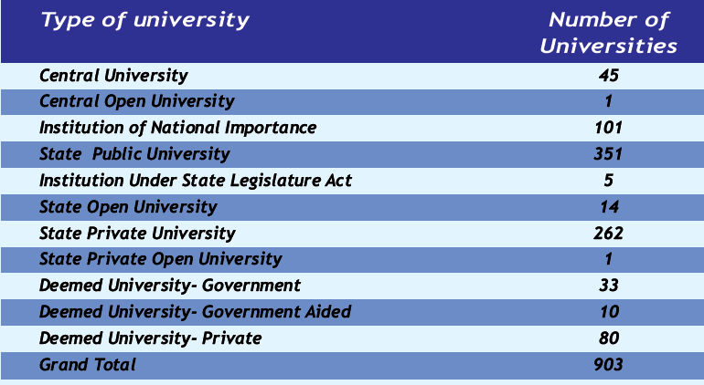
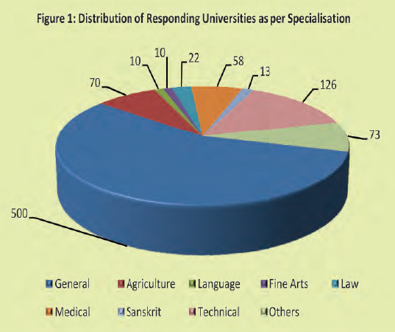
Massification of Indian HE
Indian Higher Education Institutions
Universities as per specialization
Source: AISHE Report 2018-19

Slide 6
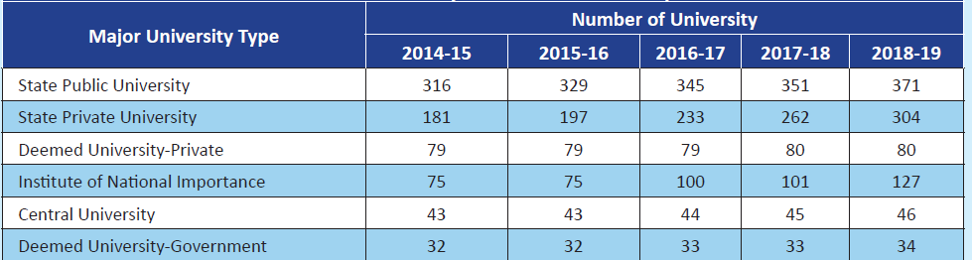
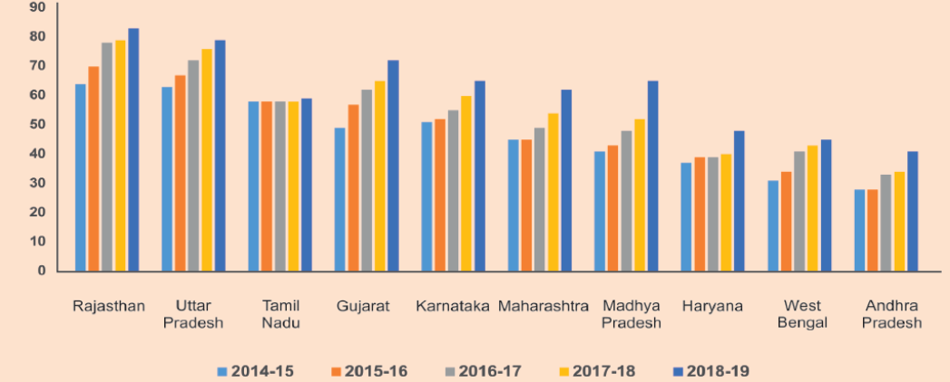
Massification of Indian HE
Number of Universities by Major states

Slide 7
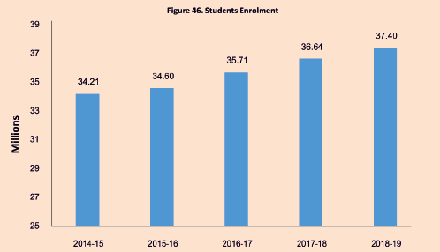
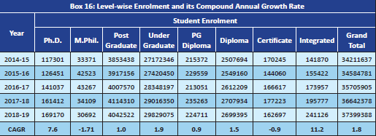
Student Enrolment (GER)
Enrolment growth
CAGR: Compound Annual Growth Rate

Slide 8
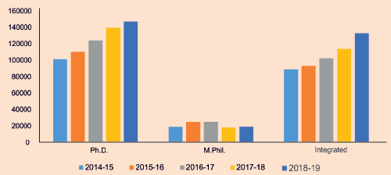
Student Enrolment for Research Programs

Slide 9
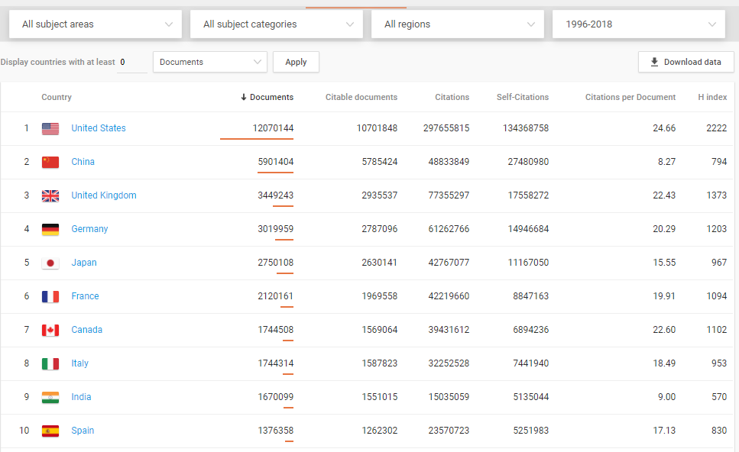
Indian SCI Publication Output: 1996-2018
(SCIMAGO Country Ranking)

Slide 10
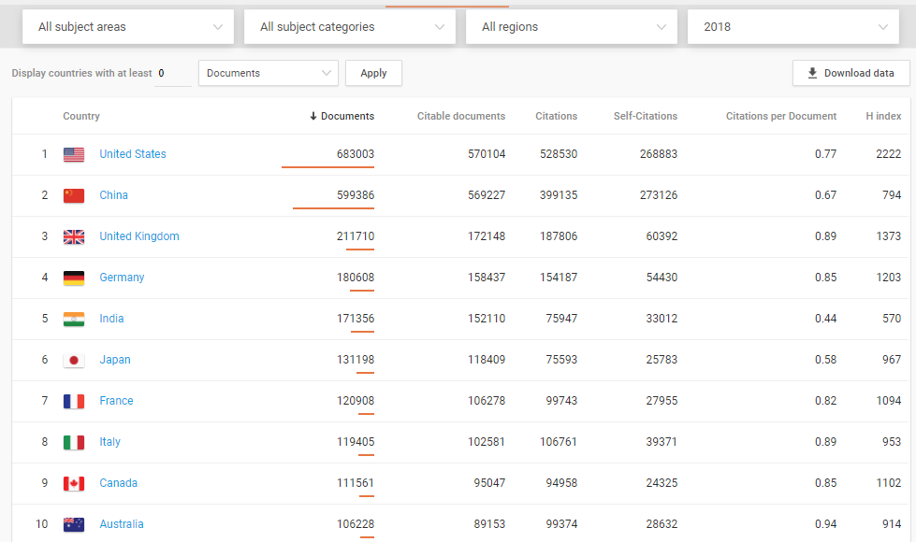
Indian SCI Publication Output- 2018

Slide 11
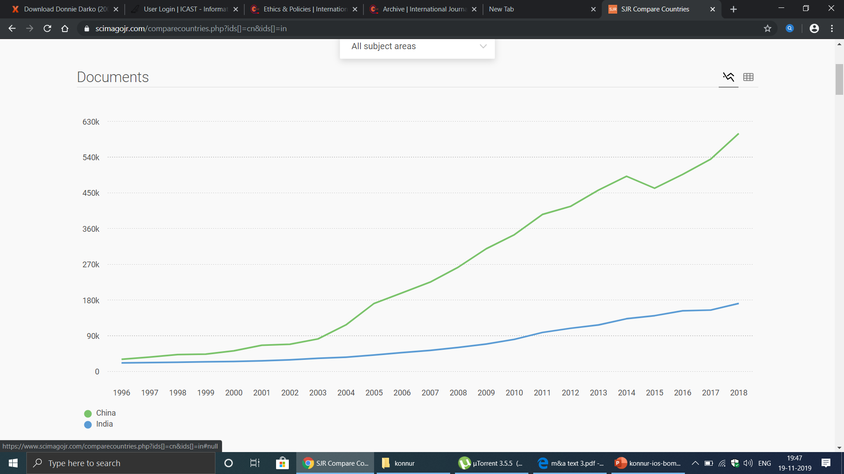
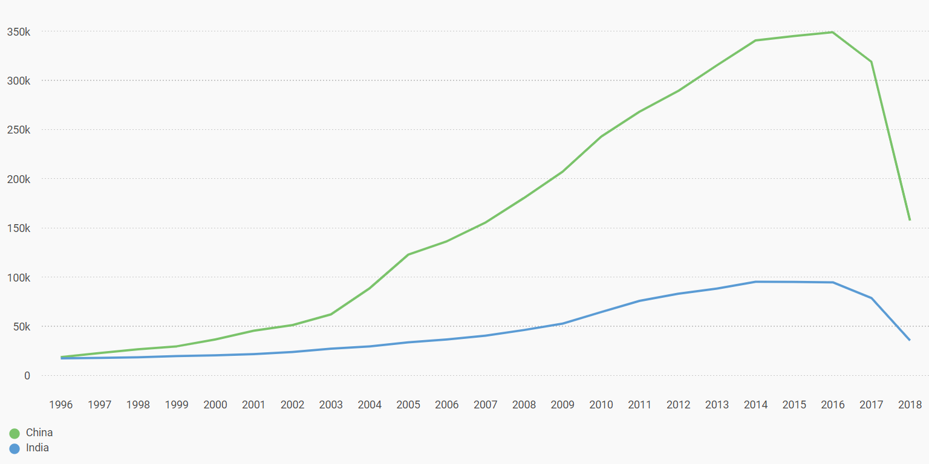
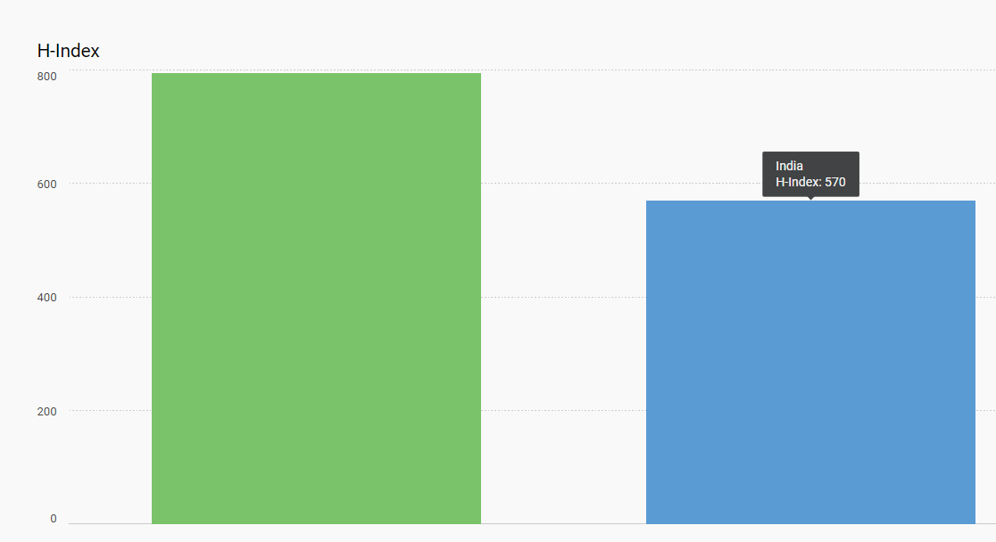
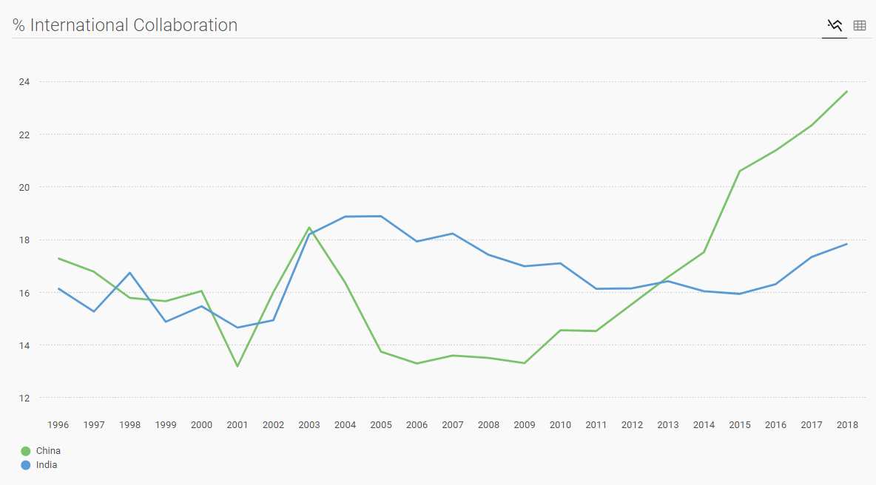
Publication Productivity: China Vs India
Publication Growth
Citations Received
H-Index
International Collaboration

Slide 12
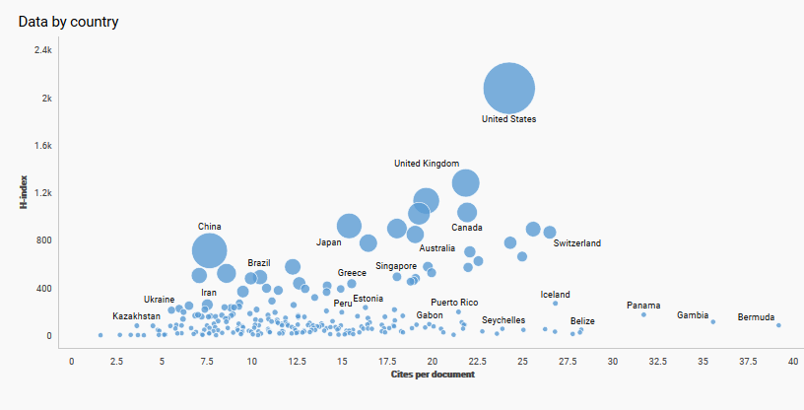
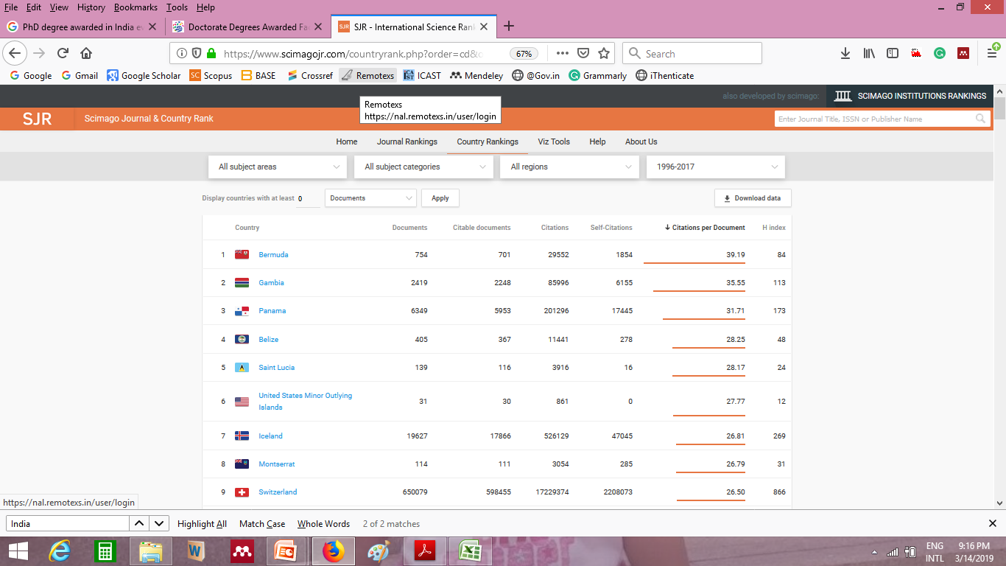
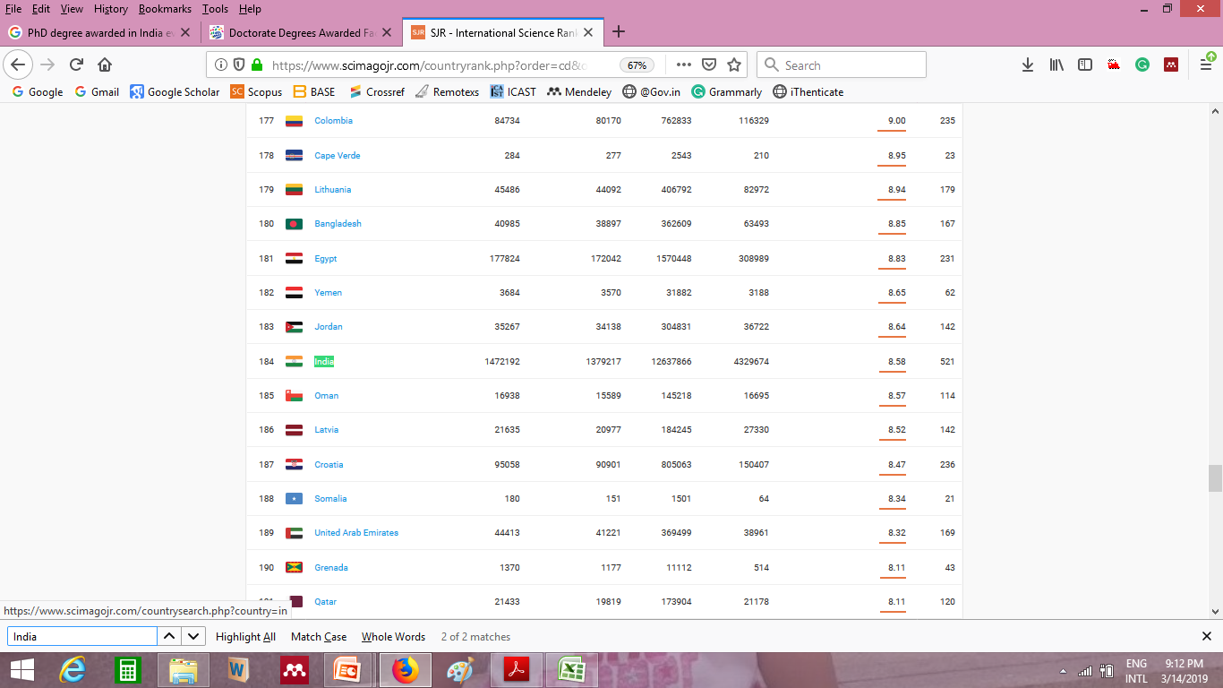
Indian Research Global Impact: Citable Documents

Slide 13
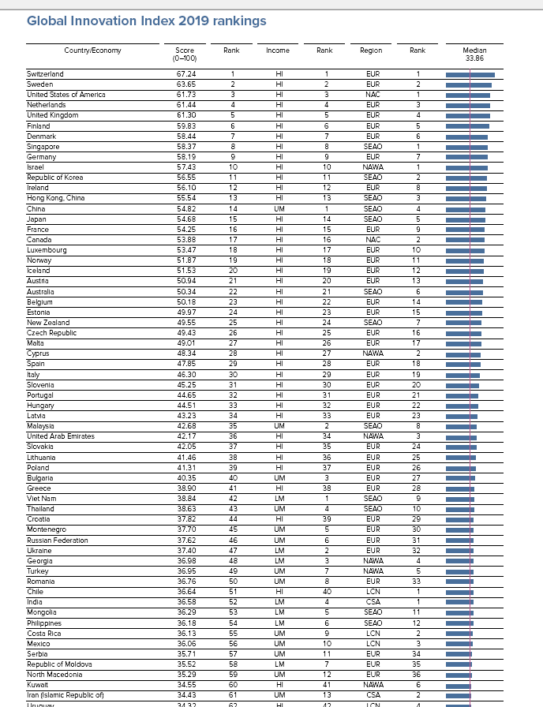
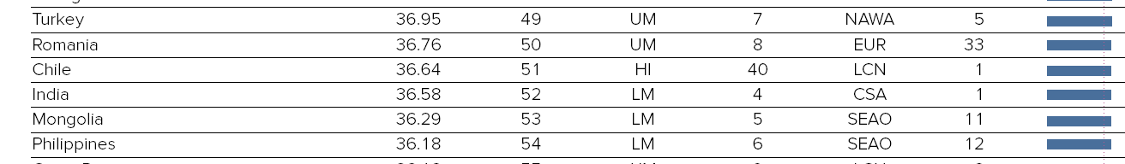
Global Innovation Index - India
Source: https://www.wipo.int/edocs/pubdocs/en/wipo_pub_gii_2019.pdf

Slide 14
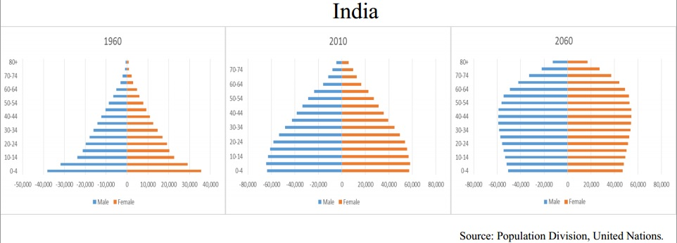
Strength of India (Man Power)

Slide 15
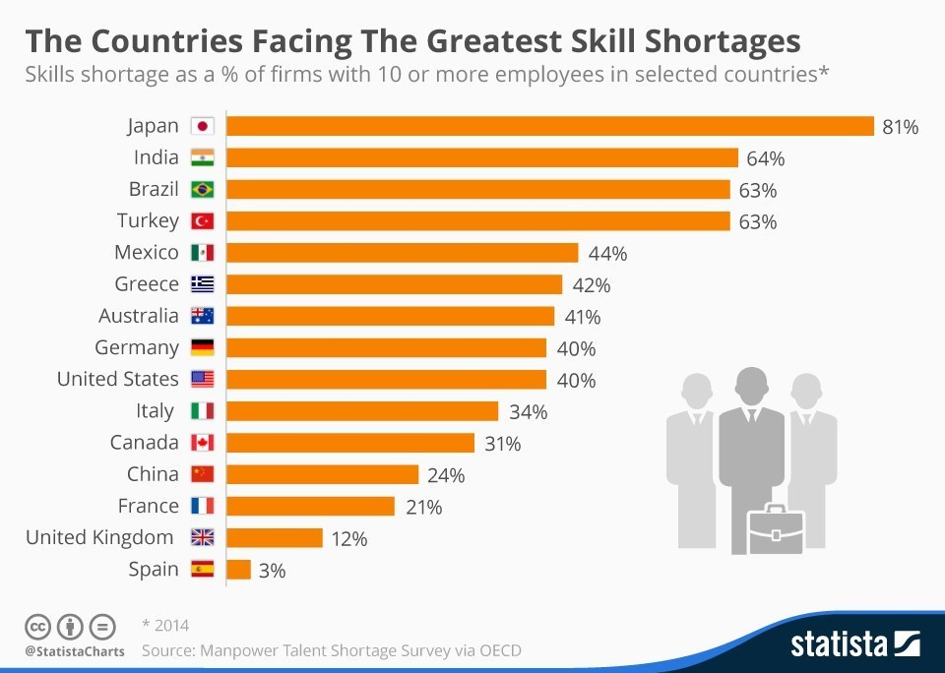
Challenge for India

Slide 16
Impediments in Indian Higher Education and Research
Deficiency in Skillset

Slide 17
Academic Research in India
  Growth in Quantity
    Number of PhDs awarded is increasing
    Large number of scholarly papers published but fails to make it to SCI journals
  Quality under questions
    Evaluation/ Assessment of Research Output
    Lack of Contemporary relevance
  Fairly good in Science and Technology
  Not satisfactory in Social Sciences, Humanities, Arts etc.,

Slide 18
Impediments in Academic Research
Lack of Research Grants
  Teachers
  Scholars/Students
Bureaucratic obstacles
Delay in Decision Making
Schedule Violations
Financial
Quality / Ethical
Impediments
Administrative
/Policy
Plagiarism
Data fabrication
Data Falsification
IPR Violation
Resources
Access Scholarly content
Quality journals from India
Access to software packages
Laboratory infrastructure

Slide 19
Ethical Issue in Scholarly Communication
Data Fabrication
Data Falsification
Duplication of Publications
Citation Manipulation
Inappropriate claims to Authorship
Copyright Infringement
Plagiarism

Slide 20
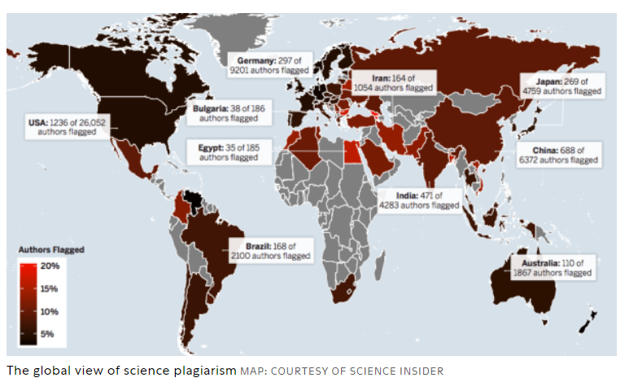
Global Plagiarism Map

Slide 21
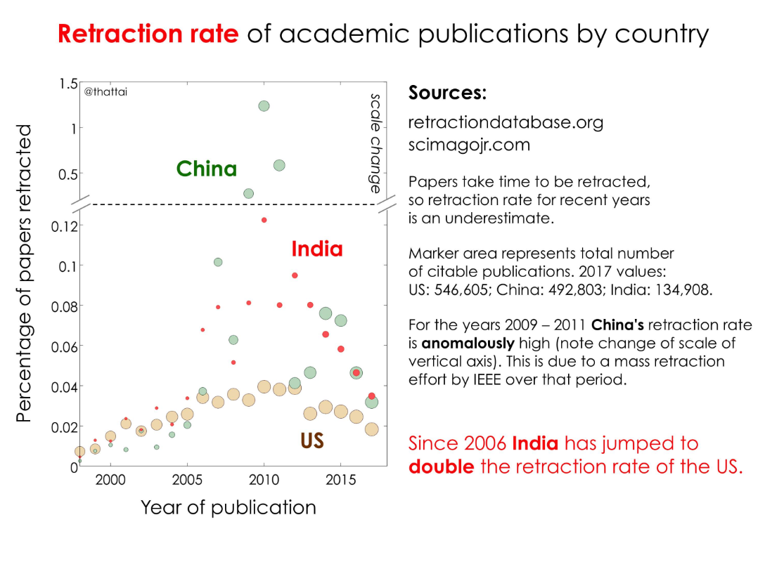
SCI Papers Retraction

Slide 22
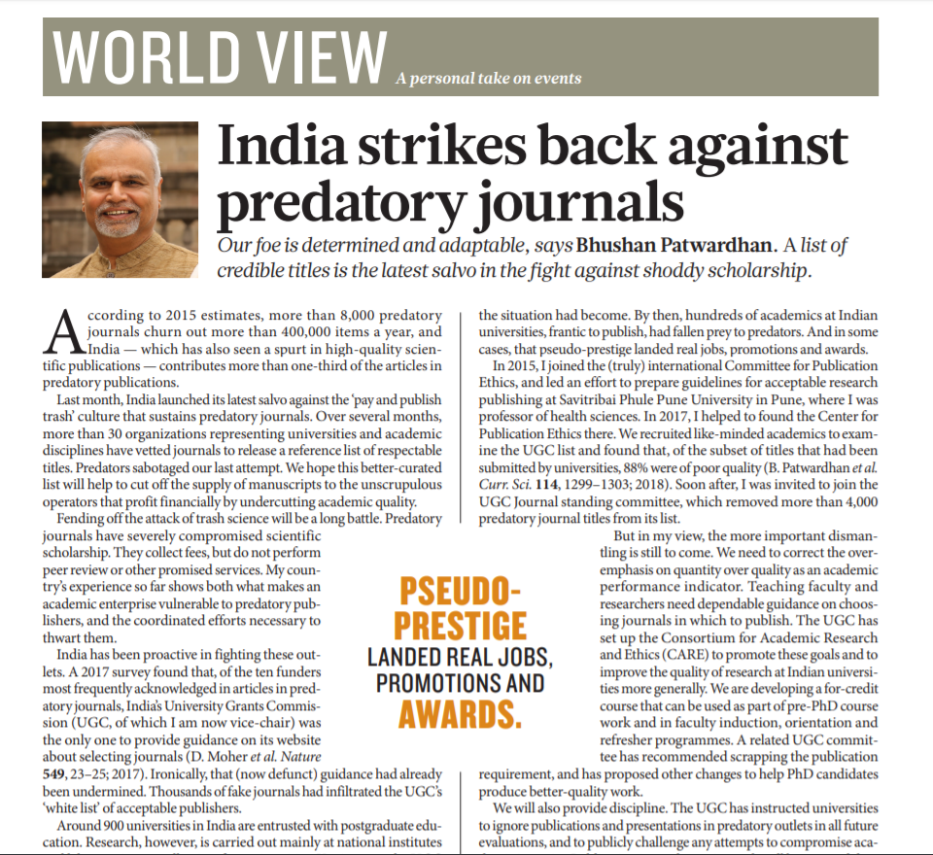
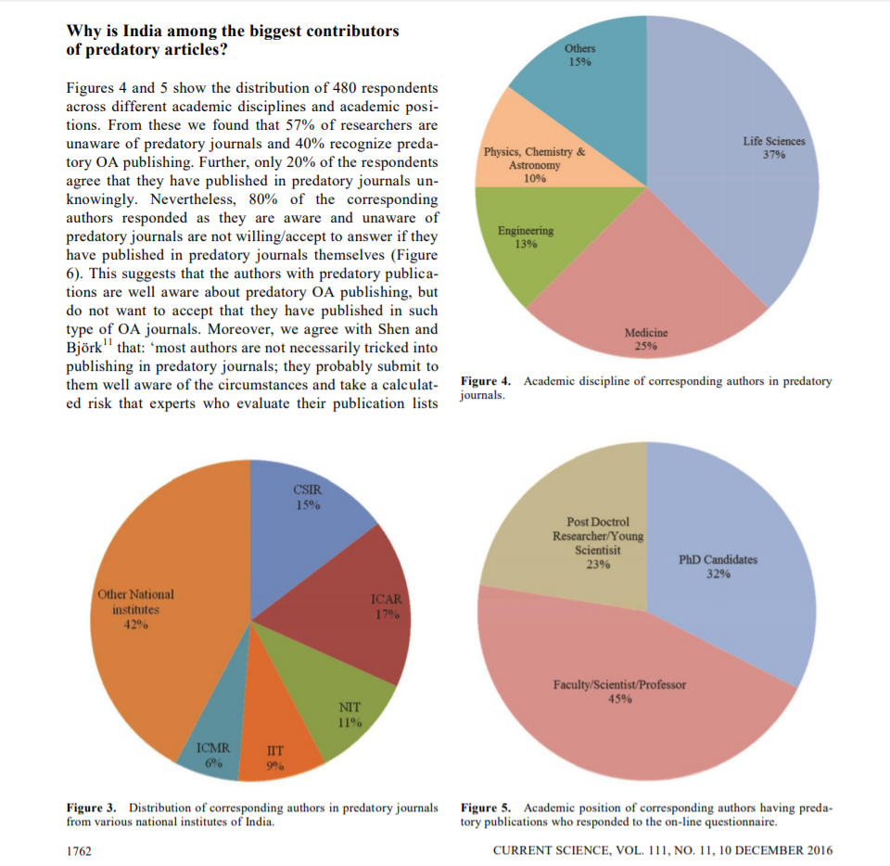
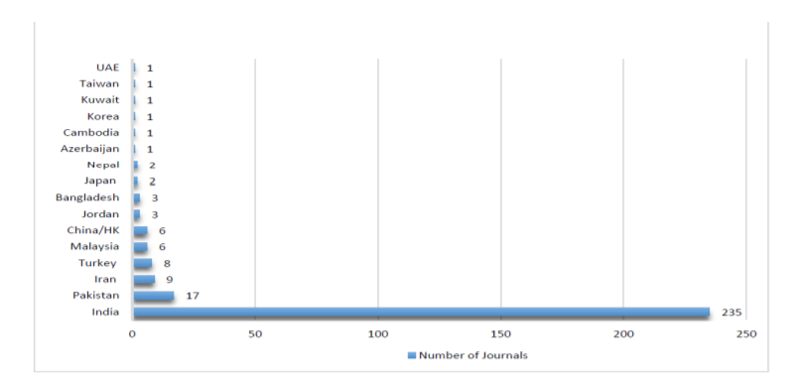
Predatory Publishing in India
Disappointing trends

Slide 23
Lack of access to Scholarly Content

Slide 24
Handicapped Access to Scholarly content
Poor Investment on Scholarly content
Dependence on other institutions for resources
Wider gap among Institutes (have’s and have not’s)
Failed National level consortia

Slide 25
NEP: Higher Education Vision by 2030
Research Universities
( focus high quality research)
Higher Education Institutes
Teaching Universities
( focus high quality teaching)
Need for Libraries to Transform
Degree Awarding Autonomous Colleges

Slide 26
Libraries in Changing Digital Scenario
Digital formats: E-Journals e-books, social media
Multi-media: No longer mostly text; it is mostly video now
Content Acquisition: data-driven administration, optimized digital services,
Connectivity: Wi-fi, broadband, 5G…
Devices: Mobiles/ Tablets always in our hands / pockets /purses
Convergence: of devices, Services, of content,
Global: no geographical boundaries,
Futures Libraries will be driven by Digital Technologies

Slide 27
Roles of Research Libraries / Librarians
Facilitating center to provide access to universal scholarly content 24X7
Information Discovery/ Retrieval skills
Information Literacy – Research Tools
Awareness about Research Ethics
Research assessment & evaluation – Metrics

Slide 28
Thank You

