Slide 1
Google Scholar as an alternate tool for Citations
Shamprasad M. Pujar, PhD
Chief Librarian, IGIDR
Satish S. Munnolli, PhD
Librarian, ACTREC
M.B. Mundgod
Librarian, Gammon Engineers
E-mail: pujar@igidr.ac.in; smunnolli@actrec.gov.in; Madhwa.Mundgod@gammonengineers.com
IOS-2019, Nov 22, 2019

Slide 2
Agenda
Introduction
What is Google Scholar Citations?
Scope of database
How to find citations from Google Scholar?
Limitations

Slide 3
Introduction
Google Scholar has became undoubtedly a preferred source for searching academic literature
Its citations service has also gained a momentum among the researchers since its inception in 2011
In spite of its limitations, it is widely hailed by many in academics owing to its coverage, speed and availability at no cost

Slide 4
Google Scholar Citations
Google Scholar data coverage is mostly from 1990s. However, in some cases, it may date back to earlier years
The Social Sciences, Arts and Humanities and Engineering coverage is more as compared Natural Sciences and Health subjects
Its coverage of digital repositories, author websites and distributed catalogues or preprints service is unique
It allows researchers to create their research profile containing publications. Search of profiles of authors affiliated to a particular institution or university is also possible
Effective in retrieving citations information up to certain numbers using third party software ‘Publish or Perish’

Slide 5
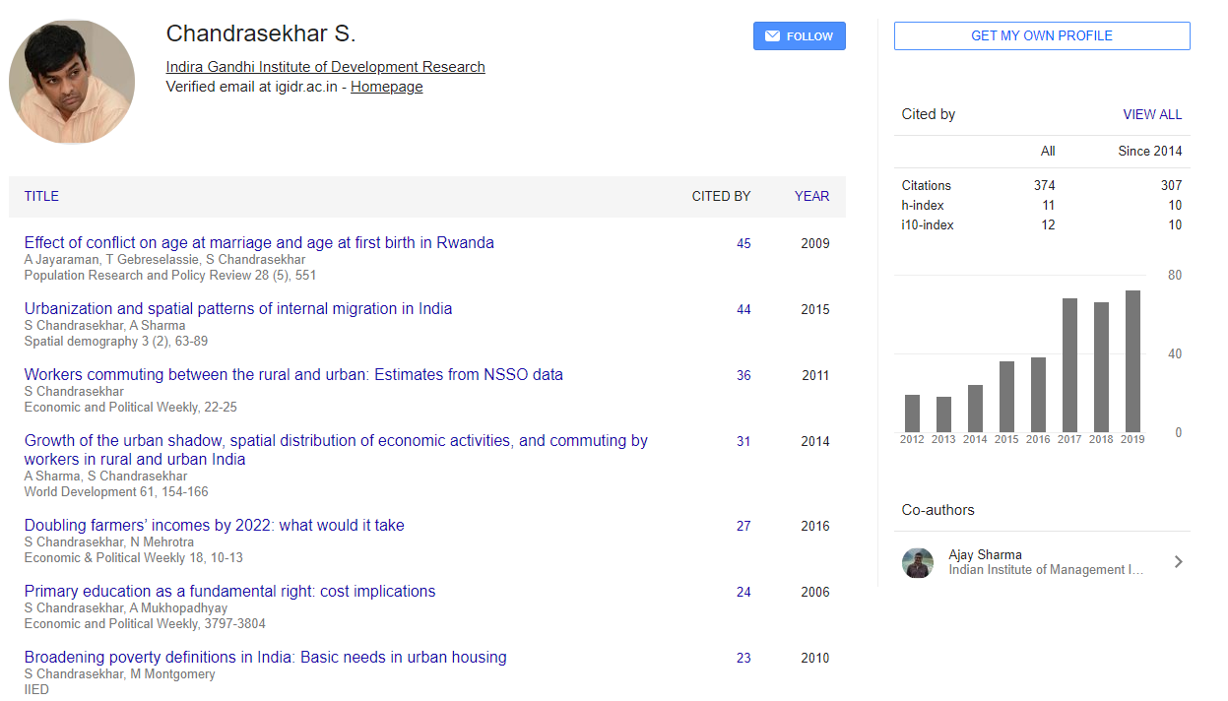
Authors Profile in Google Scholar

Slide 6
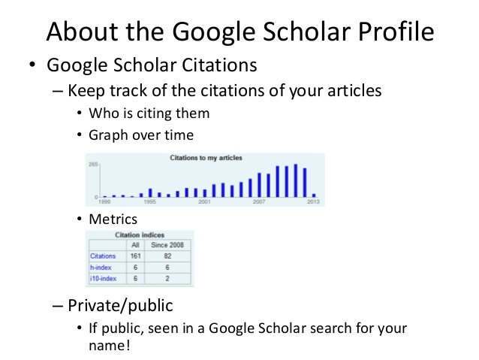
Authors Profile in Google Scholar

Slide 7
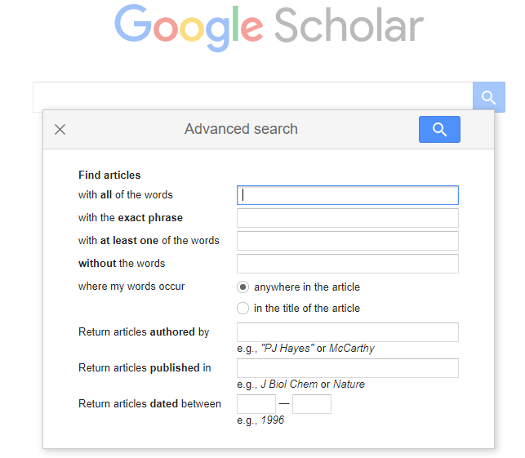
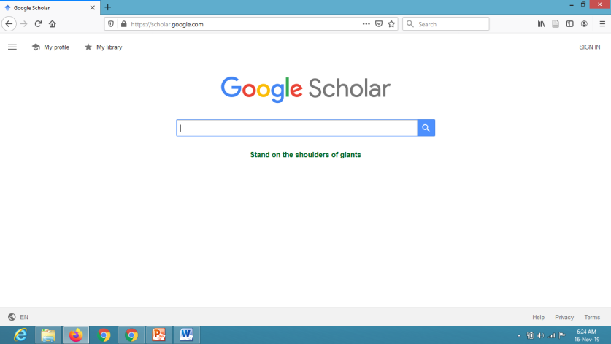
Google Scholar Citations Search
Citations for papers/articles in Google Scholar may be searched either by entering name of the author or organization or words in the title of article or journal using its simple search box or using in specified search options available under ‘Advanced Scholar Search’

Slide 8
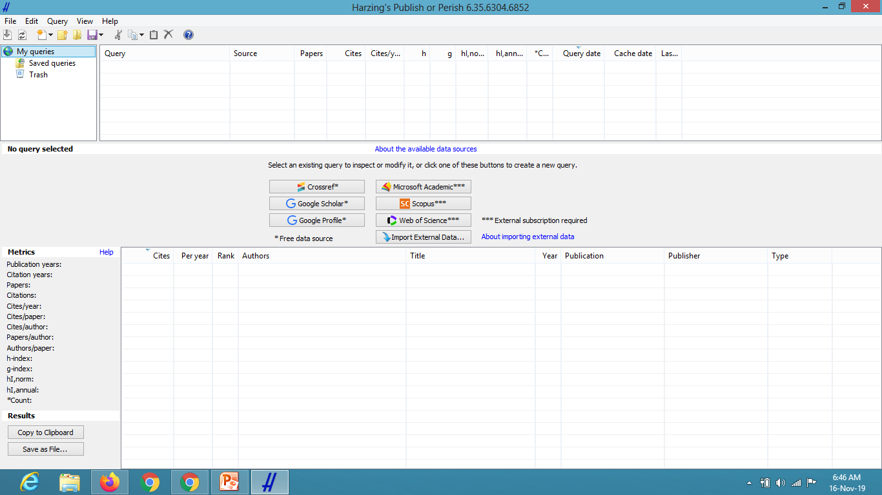
Google Scholar Citations using ‘Publish or Perish’
To enhance the citation metrics and to simplify the process of calculating the metrics from Google Scholar, software developed by Prof Harzing named ‘Publish or Perish’ can be used

Slide 9
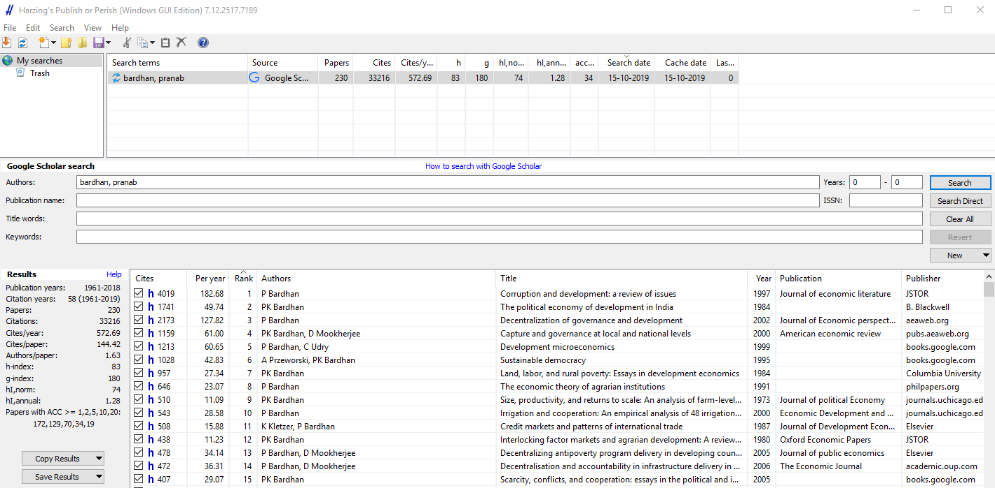
Google Scholar Citations using ‘Publish or Perish’
Search by Author

Slide 10
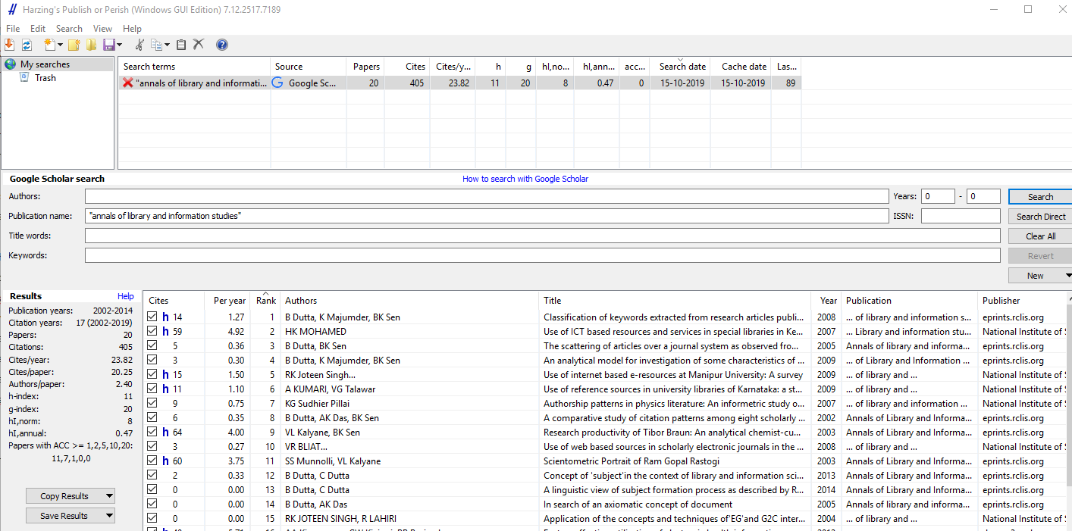
Google Scholar Citations using ‘Publish or Perish’
Search by Journal

Slide 11
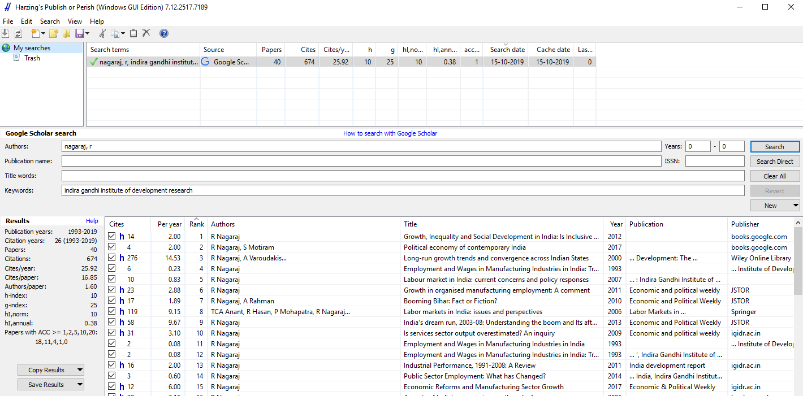
Google Scholar Citations using ‘Publish or Perish’
Search by Multiple fields including affliations

Slide 12
Limitations of Google Scholar Citations
If paper is not online, then it may not count citations for such papers
Affiliation option is not available for searching; hence it is difficult to locate searches of an author with affiliation
Boolean search is not available except ‘OR’ option
Limited coverage of non-English publications
Search results per query is limited only to 1000 records
Counts for citation metrics may be relatively easy to manipulate as they are dependent on a computer program
Subject coverage is not uniform, natural and health science coverage is limited and years of coverage starts on or after 1990, limitation regarding searches prior to 1990 (may vary across the disciplines)

Slide 13
Conclusion
In spite of its limitations, Google Scholar Citations has made its headway in academia
Blessing for researchers from developing world, as they can not afford to get access to expensive databases like ‘Scopus’ or ‘Web of Science’
Even though not recognized by regulatory bodies or organizations, it can be used for informal citations search and to create authors profile

Slide 14

Disclaimer: Ownership of the images, logos and screenshots used in the PPT belongs to the respective organizations / individuals. These are used here only for academic purpose.

