Slide 1
Scientometrics and
Readability
Dr S. K. Savanur
Former Senior Faculty
Department of Library and Information Science
Joshi-Bedekar College Thane 400 601
sksavanur@rediffmail.com

Slide 2
Scientometry and Scholarly Communication
Quantitative Aspect of science, technology and innovation
Team Research: Scholars are spread over the world
Progress depends on communication, coordination and cooperation
Time-lag between a research finding and development of its application is drastically reduced
Sharing and Reporting
This is possible because of scholarly communication

Slide 3
Essence of Scholarly Communication
Quick Understanding of the Content
Immediate Feedback
It happens in a hurry
Chances of misunderstanding or missing the whole message
Affects readability
Reader-side readability Issues
Author-side readability Issues

Slide 4
Reader-side Readability Issues
Language
Knowledge Level
Level of eyesight
Font Size
Illumination in the room
Colour of Paper and the Ink etc.
The author can’t do anything for these barriers

Slide 5
Author-side Readability Issues
The Actual Measures of Readability
External Intervention OR Editorial Touch
Possible to train the authors to achieve high readability
It is a skill that can be taught
It is possible to measure and enhance readability
Text-Editors -> MS-Word -> <Spelling and Grammar>
Through activation <Options>

Slide 6
Readability Measure Program
Readability Measurement is done by the software while scanning the text. It counts
The Number of Words
The Number of Characters
The Number of Paragraphs
The Number of Sentences computed by counting the number of Full Stops, Question Marks, Exclamation Marks and Colons.
These punctuation marks indicate the end of a sentence.
Similarly, blank space and line-space mark the end of words and paragraphs
Number of Passive Sentences

Slide 7
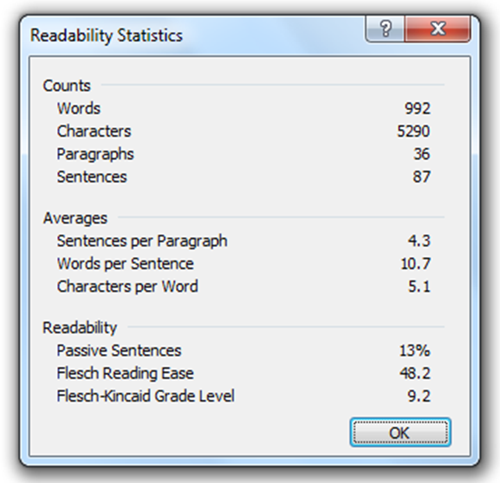

Slide 8
Measure of Readability
Rudolf Flesch Reading Ease (FRES) measures how easy it is to read a text on a 100-Point Scale
It uses ‘words per sentence’ and ‘characters per word’. Higher the value of ‘Reading Ease’, easier it is to read. That means more readability
Flesch-Kincaid Grade Level measures the number of years of education required to understand the text on hand.
This measure also uses ‘words per sentence’ and ‘characters per word’. Lesser the number of years of education required, it is easier to read. That is, more readability

Slide 9
Take-home Messages
Break the text into a number of paragraphs: thought units. But, where possible, break the text into more number of paragraphs.
Number of Sentences per paragraph must be minimum. ( 5 to 10 )
The sentences should have just 7 to 10 words to make it more readable. Legal documents can go up to 15-20 words per sentence. But, average number of sentences should be around ten.
Number of characters per word should be kept to a minimum. Words with fewer syllables are easy to understand. Eg.: Explosion-Blast, Provide-Give, Exceptional-Unique, etc. However, scholarly communication is a serious matter. It is an exception. Here longer jargons may be used.
Avoid passive sentences, if possible. Sometimes these are inevitable or necessary.

Slide 10
Exceptions / Cautions
Length of document
Number of sentences/paragraphs
Number of words /sentence
Number of characters /words
Number of passive sentences
Use your discretion, judgement and keep Readability guidelines in mind.
Thank You

